Slide 1
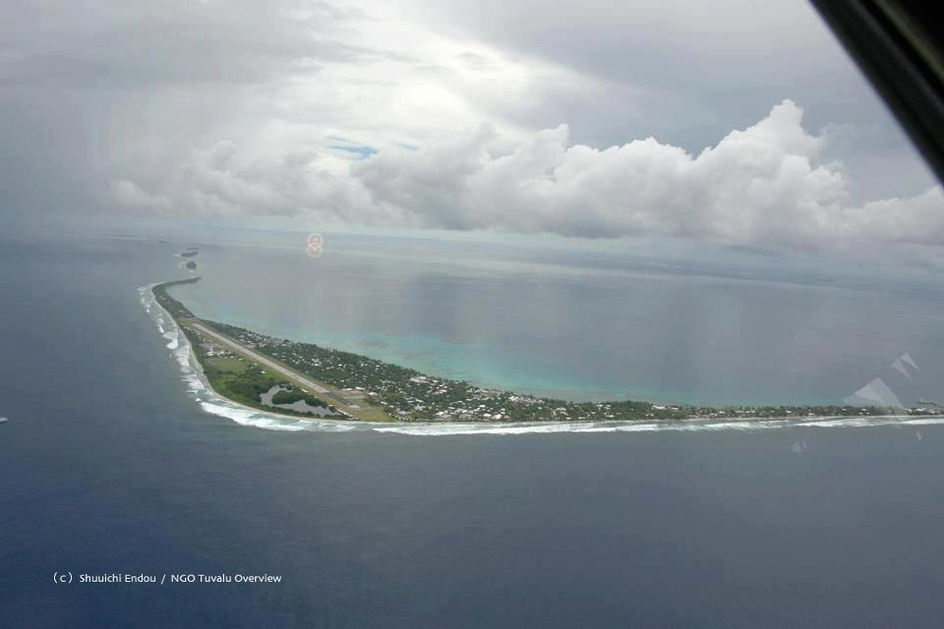
15th South West Pacific Hydrographic Commission Conference
21-23 February,2018
Tokatoka,Nadi

Slide 2
15th South West Pacific Hydrographic Commission Conference 21-23 February 2018 Tokatoka,Nadi
Tuvalu is not currently a member of the IHO, but is an associate member of the SWPHC.
One day Tuvalu hope to join the IHO in the future will be a reality

Slide 3
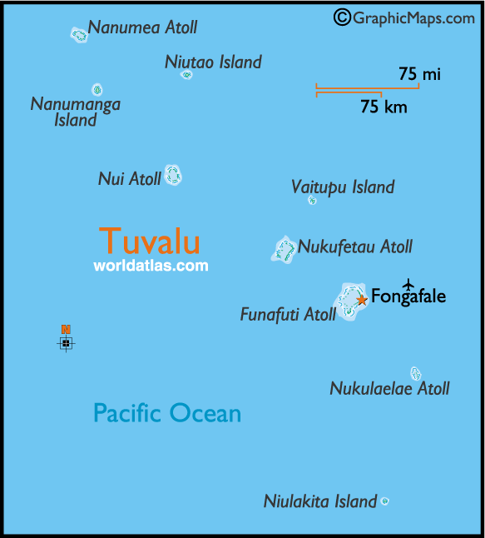
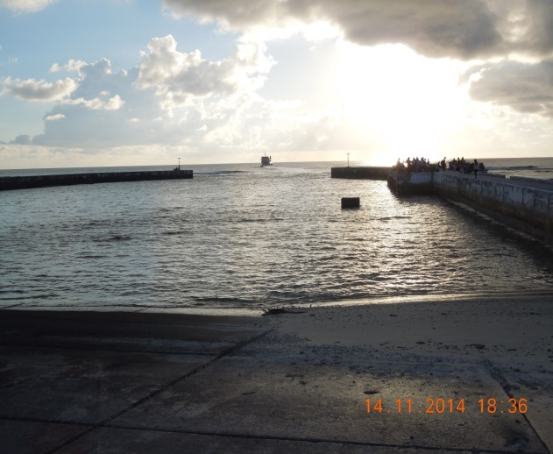
15th South West Pacific Hydrographic Commission Conference
Tuvalu became a member of IMO on the 19 May 2004. It is a signatory to twenty two (22 ) IMO/ILO Conventions. Tuvalu representative to IMO is based in London.
-Tuvalu has a reputable maritime training institute providing well trained and hardworking seafarers with the basic skills, necessary for employment as seafarer on merchant Shipping.
Tuvalu Maritime Sector is govern by six principal Acts and Regulations
3

Slide 4
Out Line of the Presentation
Background
Capacity within the Ministry
Assistance/Project
Equipment
Funding
Co- operation opportunities
Way forward

Slide 5
15th South West Pacific Hydrographic Commission Conference
Background
Tuvalu is a group of nine small coral atolls in the South West Pacific. Formerly known as the Ellice Islands, all are low-lying, with no point on Tuvalu being higher than 4.5m above sea level. The total land area is approximately 26km2, with a coastline of approximately 24km and an EEZ of 717,174km2. The current population is around 10,959 (2016 est.) people, the majority of which live on Funafuti, which is also the capital.
One of the smallest and most remote countries on Earth; several of the coral atolls - Nanumea, Nui, Vaitupu, Nukufetau, Funafuti, and Nukulaelae - have lagoons open to the ocean; Nanumaya and Niutao have landlocked lagoons; Niulakita does not have a lagoon.
The capital of Tuvalu is sometimes given as Fongafale or Vaiaku, but the entire atoll of Funafuti is officially the capital

Slide 6
15th South West Pacific Hydrographic Commission Conference
The primary source of shipping within Tuvalu is the transhipment of fish and incoming cargo for the islands. The Government also operates a passenger and supply vessel for the outer islands.
The Marine and Port Services Department, who fall under the Ministry of Communications and Transport, are both the government maritime administration and port operator

Slide 7
15th South West Pacific Hydrographic Commission Conference
Capacity within the Ministry.
There is capability for a basic maritime safety information service within Tuvalu, but currently no formal structure. The status of surveys in Tuvalu is limited, with the majority of waters entirely un-surveyed.
There is no current capacity to undertake any seabed mapping within Tuvalu, and no increase in capacity is likely in the near future
Therefore, survey activity should be explored through external agencies. The UK Hydrographic Office currently maintain a small series of British Admiralty Charts for Tuvaluan waters, although these are not able to fully support all users

Slide 8
15th South West Pacific Hydrographic Commission Conference
Continue
At the 13th SWPHC Meeting held in Cook Islands in 2015, UK announced its intention to request a Technical Visit to Tuvalu as an IHO Capacity Building activity.
This request was duly submitted on behalf of Tuvalu resulting in the approval of a Technical Assessment Visit for inclusion in the 2016 CB Workplan, to be led by the United Kingdom Hydrographic Office (UKHO).
Final financial approval was given by the IHB on the 21st October 2016, and the Technical Visit took place between the 5th and 10th November 2016.

Slide 9
15th South West Pacific Hydrographic Commission Conference
ASSISTANCE / Project
Request - SPC to visit Tuvalu 24/02/18
Request - Visit by IALA Vice Dean Mr Stephen Bennett 27/02/18
Request - for a AtN project from Korean Gov’t

Slide 10
15th South West Pacific Hydrographic Commission Conference
Equipment.
Tuvalu does not have any hydrographic equipment, but does have some limited land survey equipment. Tuvalu does not have any national capacity to conduct surveys in their waters. Any survey activity will have to be undertaken by an external organisation in the near future.

Slide 11
15th South West Pacific Hydrographic Commission Conference
Funding.
There were also made aware of capacity building and other opportunities within the IHO, IHO membership could allow to access to a range of activities. Information on the calculation of membership fees was also provided to assist with cost/benefit analysis.
The Pacific Maritime Safety Project (New Zealand) MSP is already funding the provision of guidance on governance.
The UKHO may also be able to assist with survey activity in the near future, using direct funding or through the Commonwealth Marine Economies Programme.

Slide 12
15th South West Pacific Hydrographic Commission Conference
Co-operative Opportunities
It is unlikely that Tuvalu will be able to develop a hydrographic survey capability in the near future, and therefore any data collection activity should be targeted through external bodies such as SPC and the relevant PCA.
The importance and benefits of the supply of basic MSI to relevant bodies.

Slide 13
15th South West Pacific Hydrographic Commission Conference
Way forward
Legislation to be in place 2018
MSI position to be in place mid 2018 - 2019
Training for MSI personnel
Form a IHO Committee in Country 2018 - 2019
Continue to Co-operate with PCA and SPC
To be a Member of IHO 2-3 from now.

Slide 14
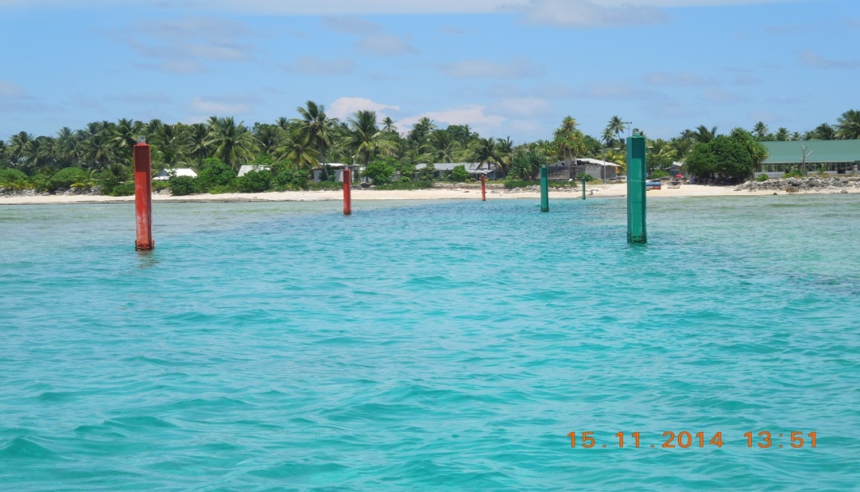
15th South West Pacific Hydrographic Commission Conference
FAKAFETAI LASI

