Slide 1
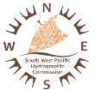
IHO SWPHC Technical Workshop on Implementing Hydrographic Governance
Nadi, Fiji, 20th February 2018
IHO SWPHC Technical Workshop on Implementing Hydrographic Governance
Notes:
Welcome to the 2-day workshop, funded through the SWPHC CB Programme
Thank you to SPC for hosting us
Welcome to IALA and GEBCO
Adam Greenland, the CB Coordinator sends his apologies…
…sent his best man
This is where hydrographic capacity building is coordinated…
…all assisting and helping build capacity in the region

Slide 2
Welcome & Introductions
Introductions
Mr Andy WILLETT
Geographic and Technical Manager – South West Pacific, Antarctica and South Atlantic Ocean
United Kingdom Hydrographic Office (UKHO)
Maritime Cartographer with over 40 years experience
Started when charts were engraved on copper plates, through to modern day computer generated S-57 cells. Chair of IHO Hydrographic Commission Antarctica Hydrography Priorities Working Group. INT chart coordinator for Region M. Member of the IHO SWPHC International Chart Coordination Working Group
Notes:
White enamel coated zinc plates where charts were drawn with fine brush and nibs with black ink. Then scribed with fine sapphires onto coated plastic

Slide 3
Hydrographic Awareness and economic benefit Vanuatu
Hydrographic Awareness
Risk assessment to identify need for surveys and consequential improvements in charting to enable a nation to meet their international obligations
In addition to bathymetric surveying, associated tasks conducted to further existing limited knowledge. Installation of tide gauges, establishment of permanent geodetic stations and testing of water quality.
Continual monitoring of AIS data to highlight congested areas and identify possible requirements for improved charting and the need for new /improved navigational aids
Notes:
Scenario for Vanuatu. What is risk assessment??
Risk assessment conducted by NZ
Tide gauges for future survey validations
Geodetic stations to tie in bigger areas
AIS very important tool for monitoring vessel movements

Slide 4
Hydrographic Awareness and economic benefit Vanuatu
Economic benefit
Tourism. Modern user defined charting providing large scale coverage of new and existing cruise vessel destinations. This is the driver of Vanuatu’s economic growth and a mainstay of it’s economy. This will balance the economic benefits of tourism and maintain the healthy and sustainable marine environment , which helps to attract visitors
Transportation. Hydrographic survey work facilitates the safe transport of goods to market, and surveys of coastal areas supports the development of ports and harbours essential for economic growth.
The collection of scientific data and surveys will contribute significantly to the studies being conducted on water quality, fisheries eco-systems, climate change and the way we respond to natural disasters, specifically the frequency of cyclones
Notes:
Tourism. Important for large vessels to have modern large scale coverage. If it’s too risky the Cruise companies will not visit and deny any benefits to nation
Transportation. New and improved coastal navigation charts containing latest surveys gives passage planning a better degree of safety and timeliness.
Very important SOLAS responsibility.

Slide 5
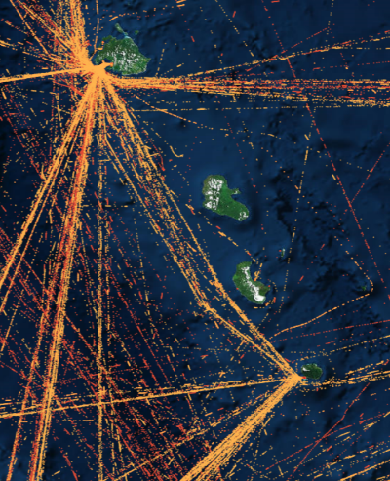
Monitoring trends in vessel movements through AIS tracking
AIS coverage of Northern and Southern Vanuatu
Notes:
AIS very important tool for monitoring type and amount of vessel movements. This method of tracking is used more and more by HO’s to plan surveying and charting needs
Main traffic to and from Port Vila

Slide 6
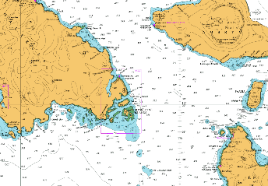
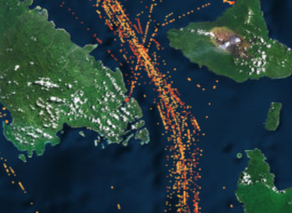
LINZ Pacific Regional Hydrography Programme – Hydrographic Risk Assessment VANUATU
Proposal for additional chart to provide improved coverage of potential “pinch point” between Malakula and Epi/Ambrym
Existing BA1570 1:300,000
Potential “pinch point”
Proposed New Chart 1:125,000
Notes:
UK next priority following LINZ risk assessment
New chart to alleviate pinch point

Slide 7
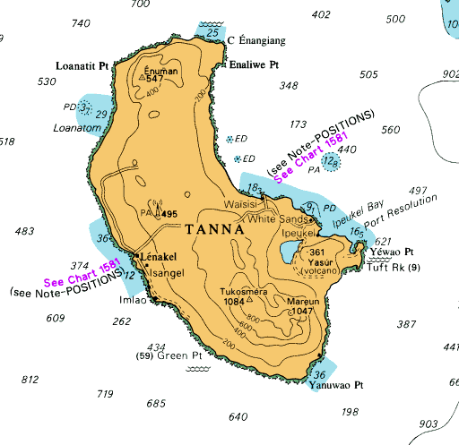
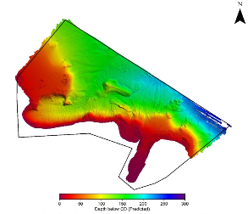
Port Resolution, Tanna Island
Previous coverage BA1576 1:500,000
New coverage BA1581 1:15,000
Notes:
Most recent new coverage for cruise vessels

Slide 8
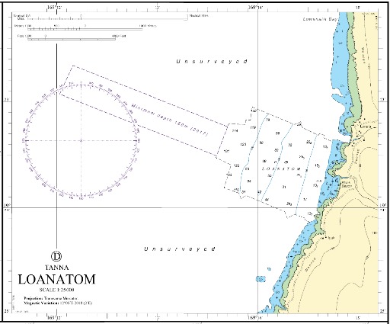
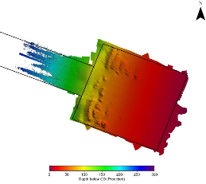
Loanatom, Tanna Island
Previous coverage BA1576 1:500,000
New coverage BA1581 1:25,000
Notes:
Old 3.7m shoal depth was PD. It is not within survey area showing safe corridor into anchorage.

Slide 9
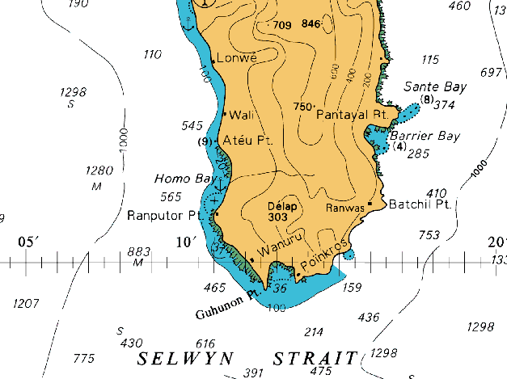
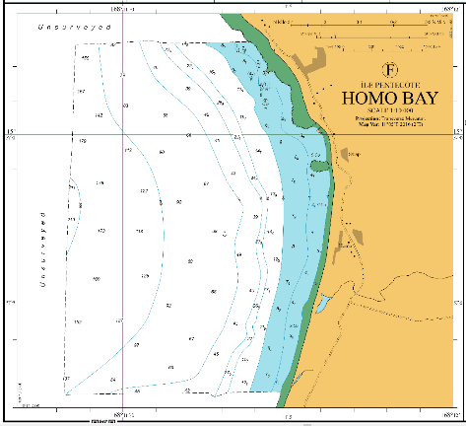
Homo Bay, Île Pentecôte
Previous coverage BA1570 1:300,000
New coverage BA1577 1:10,000

Slide 10
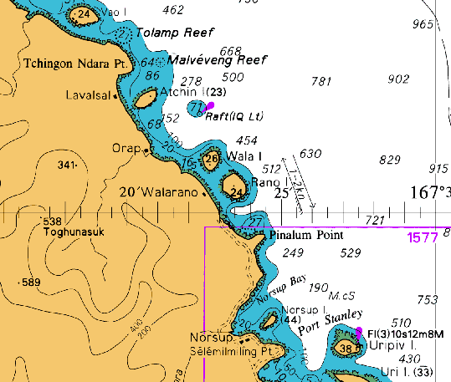
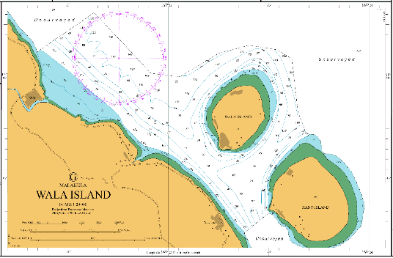
Wala Island, Malakula
Previous coverage BA1570 1:300,000
New coverage BA1577 1:10,000

Slide 11
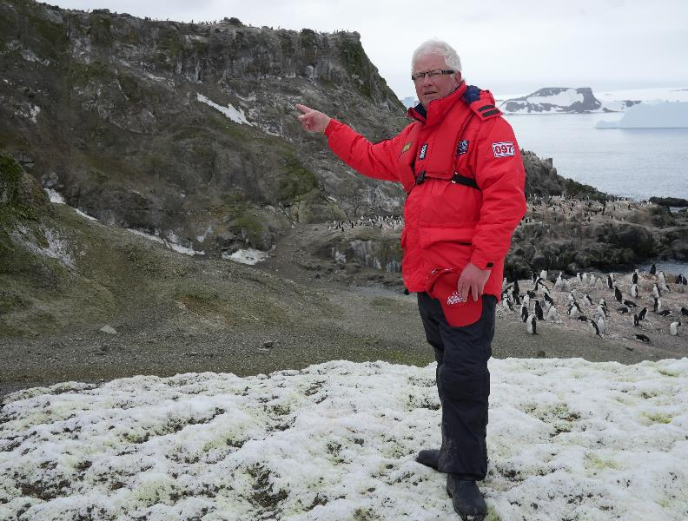
Thank you
Any
Questions?

