Slide 1
IHO SWPHC Technical Workshop on Implementing Hydrographic Governance
Nadi, Fiji, 20th February 2018
Papua New Guinea
Implementing Hydrographic Governance
Notes:
Welcome to the 2-day workshop, funded through the SWPHC CB Programme
Thank you to SPC for hosting us
Welcome to IALA and GEBCO
Adam Greenland, the CB Coordinator sends his apologies…
…sent his best man
This is where hydrographic capacity building is coordinated…
…all assisting and helping build capacity in the region

Slide 2
IHO SWPHC Technical Workshop on Implementing Hydrographic Governance
Principle Charting Authority, Australia
NMSA became operational in 2005
1978 MOU between with Australia revised to reflect organizational changes

Slide 3
Hydrographic Surveys
Australian Hydroscheme (RAN Surveys)
PNG NMSA Outsourced Contracts
Private Surveys (PNG Ports)

Slide 4
Charts and Publications
Product | Description
AUS Paper Series | A total of 88 paper charts
AusENC | Pack (VOY 02) has 168 ENC Cells
Aus GeoTIFFs | Raster images of paper charts for use in GIS
Publications | AusTides CD, ANTT, Notice to Mariners
 | Admiralty Sailing Directions (NP 15 & 60) Admiralty Light List (Vol. K)

Slide 5
Updating Charts and Publications
Notice to Mariners via email (Temporary notices)
Hydrographic Notes (H102 Form)
Survey Summary
Advice to Hydrographer (ATH Form for AtoNs)

Slide 6
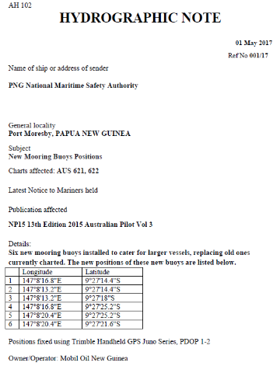
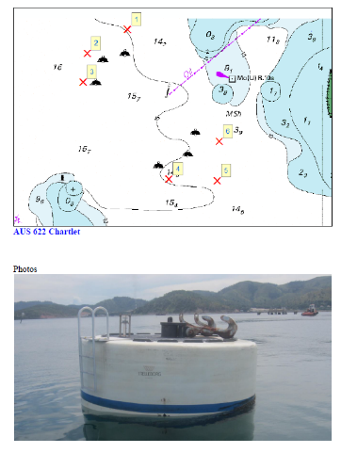
Updating Charts & Publications
Example of Hydrographic Note
Sent via: datacentre@hydro.gov.au

Slide 7
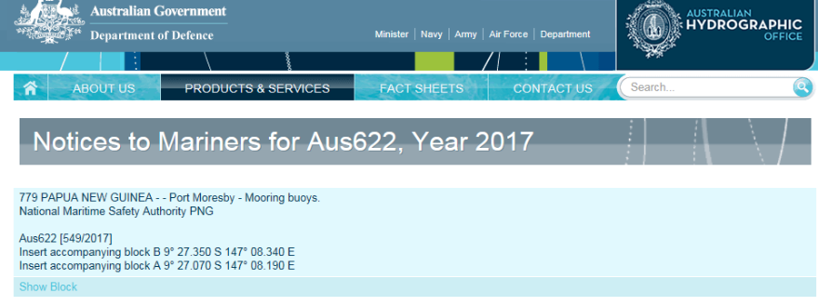
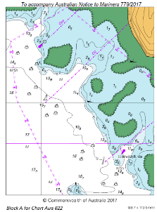
Updating Charts & Publications
ACI – Example of PNG Update
http://www.hydro.gov.au/webapps/jsp/charts/chartlist.jsp

Slide 8
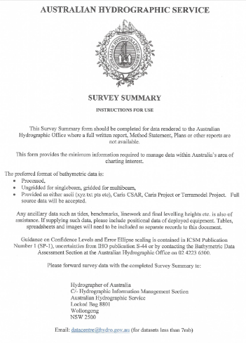
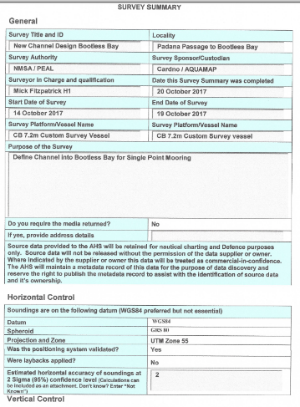
Updating Charts & Publications
Example of Survey Summary
Sent via: datacentre@hydro.gov.au

Slide 9
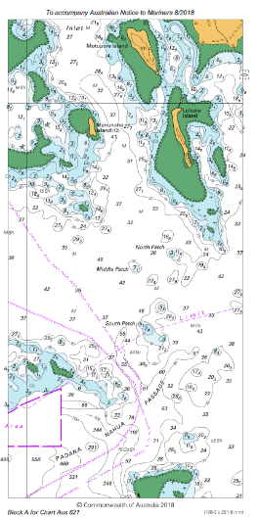
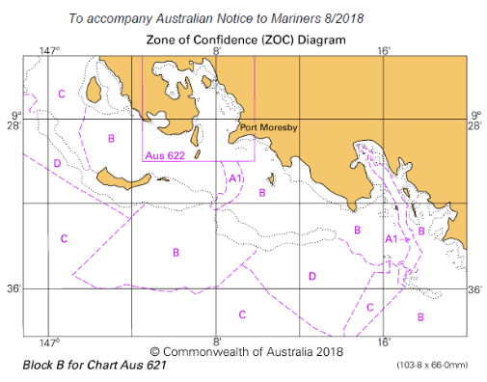
Updating Charts & Publications
AUS Notice to Mariners (Block)

Slide 10
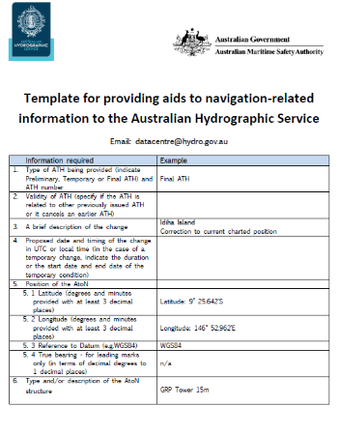
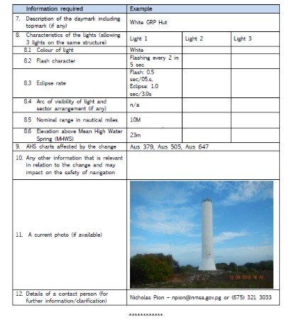
Updating Charts & Publications
Example of Advise to Hydrographer - for AtoNs
Sent via: datacentre@hydro.gov.au

Slide 11
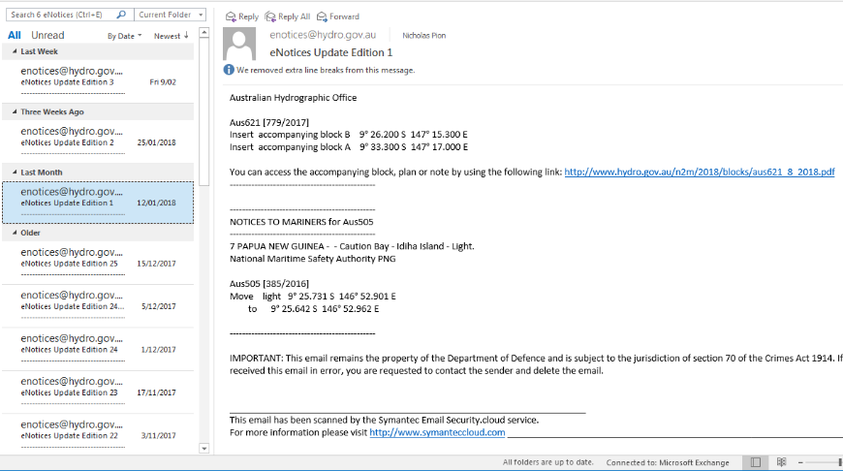
Updating Charts & Publications

Slide 12
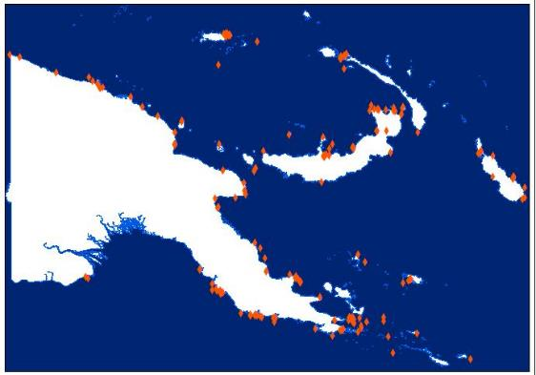
Aids to Navigation
Aids to Navigation regulatory Fee
AtoN maintenance contract
A total of about 300 AtoNs
Community Engagement Program (CEP)

Slide 13
Donor Funding
Asian Development Bank
ADB Loan 2978-PNG Maritime & Waterways Safety Project (MWSP)
Component: Hydrographic Surveys (Fugro)
Purpose: Improve nautical chart coverage, accuracy and density, safety of international and local shipping and tourism throughout the country.
Total Area: 1800km² out of 2500km² as of mid February
Tide gauges: Deployed and recovered 7 so far
Wrecks: Found several uncharted wrecks, possibility of more

Slide 14
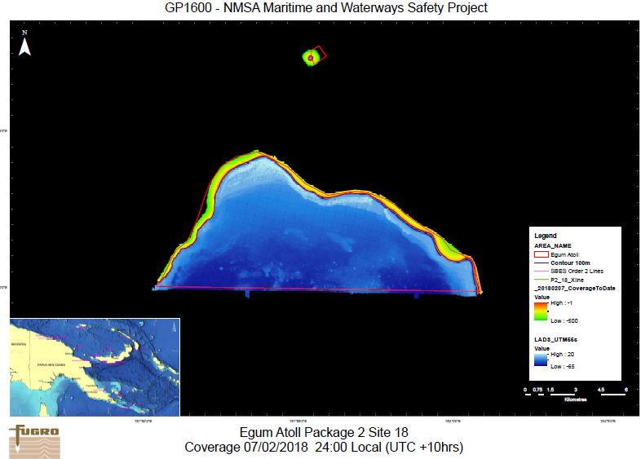
Donor Funding
Asian Development Bank
ADB Loan 2978-PNG Maritime & Waterways Safety Project (MWSP)

Slide 15
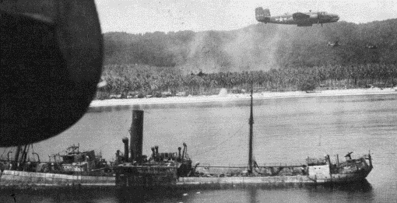
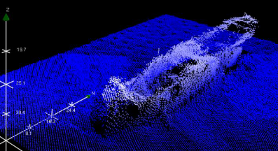
Uncharted Wrecks
Uncharted Wrecks identified under the ADB MWSP
Site | Kairiru Island/Victoria Bay
Determination | Multibeam
Length/Beam | 90m / 13m
Description | Japanese Merchant ship sunk in 1943 lies in 37m of water, least depth 25m

Slide 16
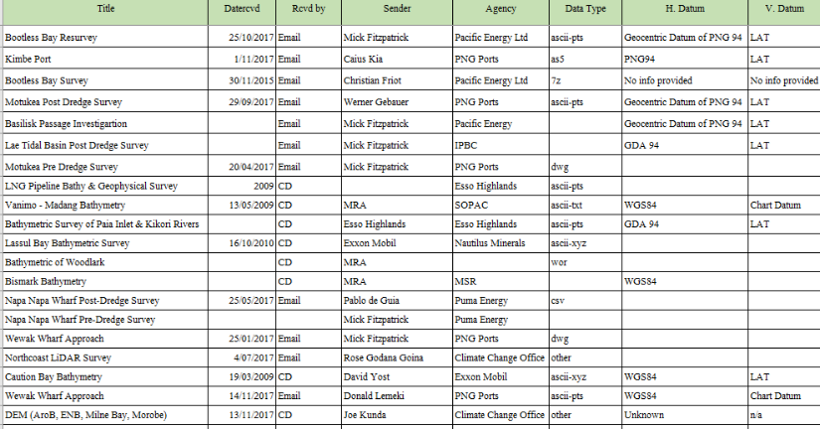
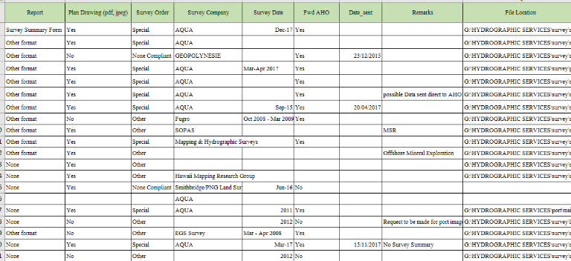
Spreadsheet Incoming Data

Slide 17
Challenges
Managing hydrographic and geospatial data
Missed opportunities for data to improve data coverage
Awareness at higher government level

Slide 18
Point of Contacts
CMDR Fiona Freeman RAN | Hydrographer of Australia | SWPHC, MoU,
Jasbir Randhawa | Director International Relations | Capacity Building, International Liaison
CMDR John McGannon, RAN | Deputy Director Hydrographic Plans & Standards | Hydroscheme
NAVAREA X Coordinator | Australian Maritime Safety Authority | Nav Warning/SAR
Solomon Islands | Solomon Islands Safety Authority | Nav Warning/SAR

Slide 19
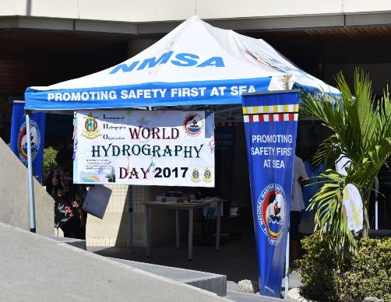
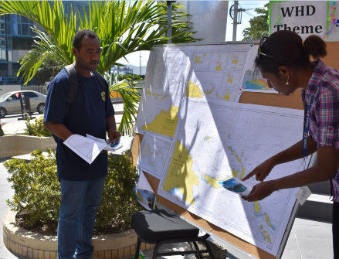
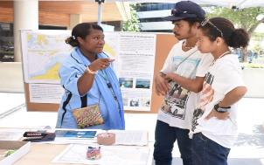
WORLD HYDROGRAPHY DAY 2017
WHD Observed on 21 June through public Information Booth setup, incl. videos on hydrography and aids to navigation

Slide 20
IHO SWPHC Technical Workshop on Implementing Hydrographic Governance
Nadi, Fiji, 20th February 2018
Papua New Guinea
Implementing Hydrographic Governance

