Slide 1
South West Pacific Hydrographic Commission Technical Workshop February 2018
Australia – PCA for Solomon Islands

Slide 2
How it began
Discussions commenced after 2012 SWPHC meeting in Brisbane
UKHO, Australia and Solomon Islands agreed in principle and worked together to plan the changeover
Meetings held in Australia in 2016 to discuss technical detail and chart prioritisation
UK provide chart and ENC bases in Dec 16

Slide 3
What was achieved
Solomon Islands ENC producer code prefix ‘SB’ in accordance with the United Nations’ two letter country designator and the relevant IHO specifications.
Solomon Islands paper chart prefix ‘SLB’ in accordance with the United Nations’ three letter country designator.
41 SB ENCs (14 Harbour and 28 Coastal)
14 SLB Paper Charts + 2 SLB Index charts (PC and ENC).

Slide 4
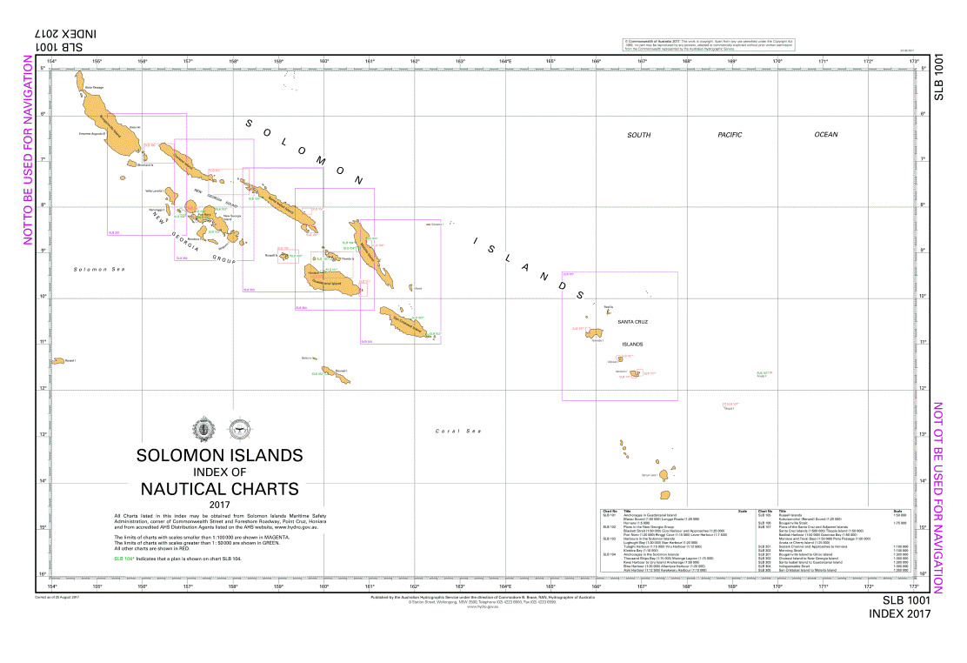
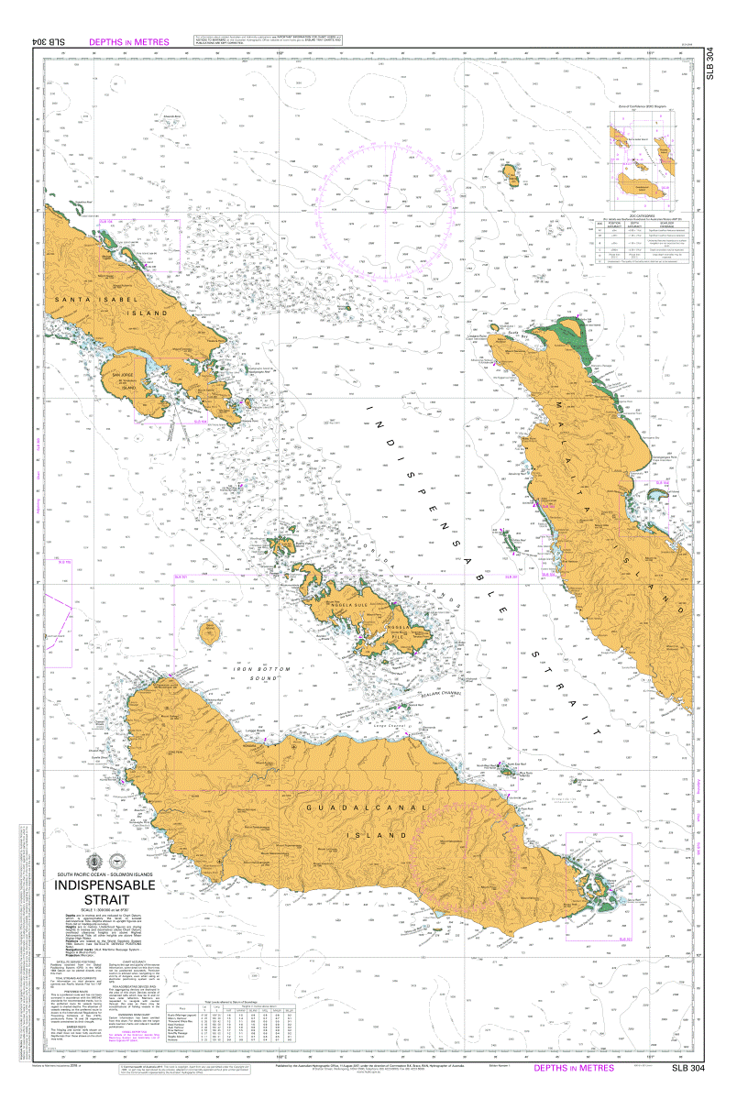
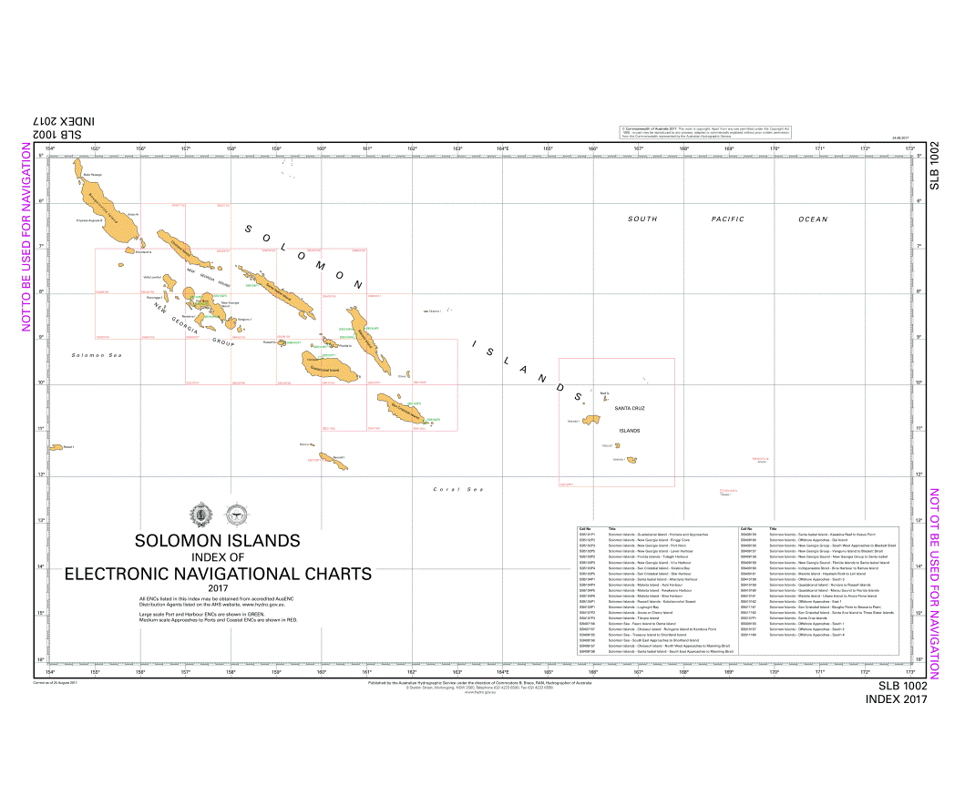
SI coverage and example chart

Slide 5
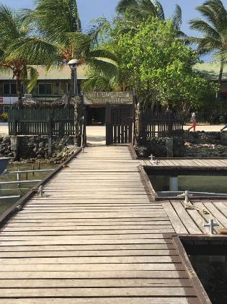
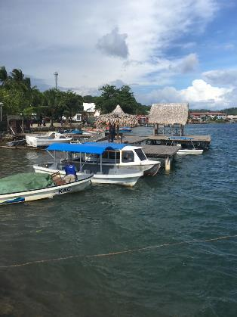
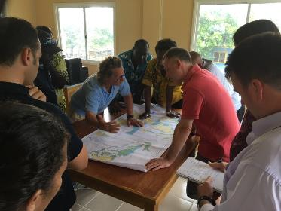
AHO staff visited Honiara
Deputy Hydrographer and Deputy Director Chart Production visit in Feb 2016 with Carnival Cruise representatives
Meetings were also held with Solomon Islands Hydrographic Unit, SI Maritime Police, Aus Navy patrol Boats, Gizo toursim officials and Honiara Shipping Agents.

Slide 6
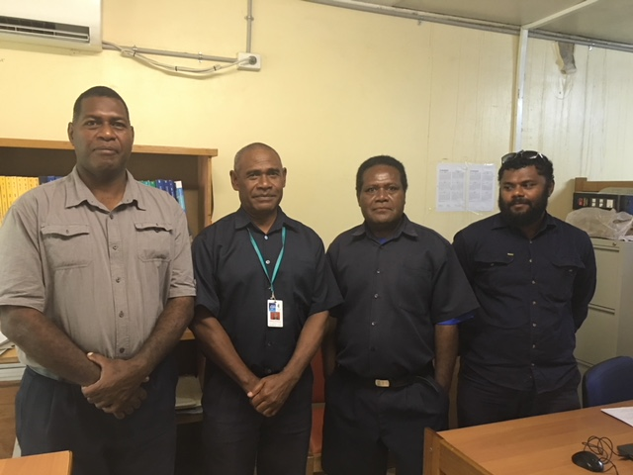
Solomon Islands Hydrographic Unit (SIHU)

Slide 7
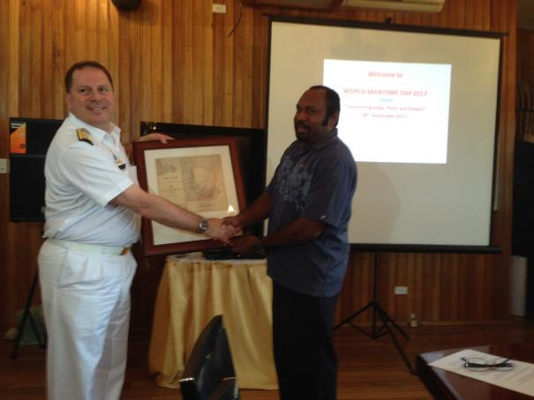
Memorandum of Understanding Signing
Australian Hydrographer and AHO Production Manager visit to sign Memorandum of Understanding and celebrate World maritime Day with SI Govt officials

Slide 8
What next
Need to improve the supply of source data from SI to Australia, via “Ourshare” electronic connection
Large scale ENC and paper charts of International trading ports are underway – Honiara, Noro, Gizo.
A new chart of Marovo Lagoon has been proposed to meet Solomon Islands domestic charting requirements.
Solomon Island Tide Tables are being compiled and will be published in October for 2019.
Hoping to have SI cartographer undertake some chart editing training at AHO.

