Slide 1
Professional development for hydrographers
Technical Workshop SWPHC15 – Nadi Fiji

Slide 2
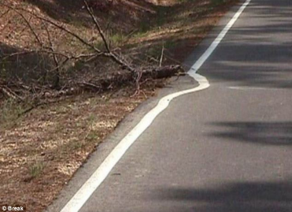
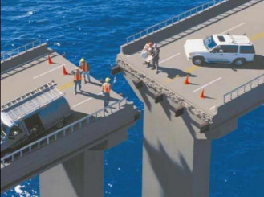
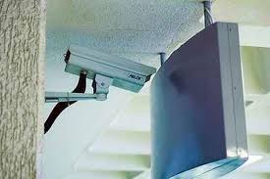
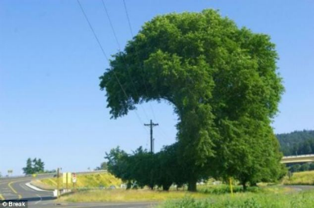
What is professional competence?
Oops!
Notes:
Some funny examples of questionable ‘professional competence’ ……

Slide 3
What is professional competence?
Professional Competence
Abilities
Attitudes
Behaviours
Knowledge
Experience
Notes:
A combination of all these things makes a person professionally competent and able to perform their job well. Having a long list of qualifications doesn’t necessarily make a person good at their job.
And some of these attributes may result from natural talent or even individual personality - but even those things can be changed or improved by self motivation and determination.
And of course ‘knowledge’ is the reason you are here at the workshop and something we can always try to gain more of.
Albert Einstein once famously said that “Wisdom is not a product of schooling but of the lifelong attempt to acquire it”

Slide 4
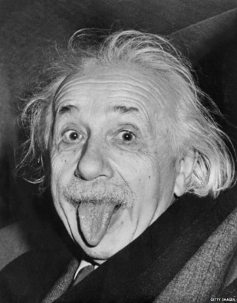
What is CPD?
Continuing Professional Development
“Wisdom is not a product of schooling but of the lifelong attempt to acquire it”
Albert Einstein
Notes:
So Albert Einstein provides a very good definition of what is known as “CPD” or “Continuing Professional Development.”
In essence it is the concept of continuing to learn long after you’ve gained your initial qualifications or training. It is a commitment to keep learning and gaining knowledge throughout your career.

Slide 5
Why is CPD important?
Technology
New technologies emerge
Compliance
New global regulations are introduced
?
The unknown challenges and threats
Environment
Environmental conditions & patterns change
Notes:
So why is CPD important? The world around us does not stand still. It keeps changing. We need to keep up to date with the many changes that are constantly happening around us so we can respond and progress and continue to be good at our jobs.

Slide 6
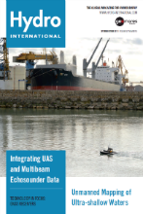
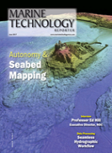
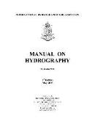
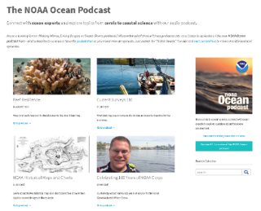
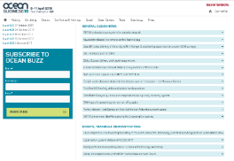
Accessing knowledge
Books, magazines, journals, newsletters, online
IHO PUBLICATIONS: https://www.iho.int/iho_pubs/IHO_Download.htm
IFHS READING LIST: http://www.hydrographicsociety.org/documents/hydrographicsociety.org/downloads/ifhs_recommended_reading_list.pdf
IHO Manual on Hydrography:
https://www.iho.int/iho_pubs/CB/C-13/english/C-13_Chapter_1_and_contents.pdf
Selection of
https://www.thsoa.org/news
https://oceanservice.noaa.gov/podcast/
http://www.oceanbusiness.com/oceanbuzz/issues
Notes:
This is just a small selection of examples but there is a huge range of information and knowledge available through magazines, journals and newsletters and an enormous amount of online resources – many which can be accessed for free.
The International Federation of Hydrographic Societies has an excellent reading list which outlines many of the key publications which you can access or subscribe to.
The International Hydrographic Organization has a lot of resources in multiple languages available to download on their website.
The Ocean Buzz newsletter keeps you up to date with industry news and events from around the world.
The NOAA website has a wealth of resources and information including the ocean service website which has free podcasts to download

Slide 7
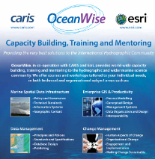
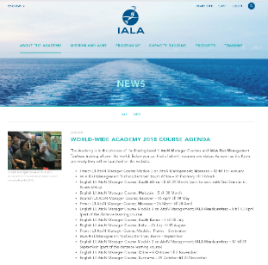
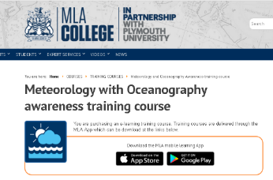
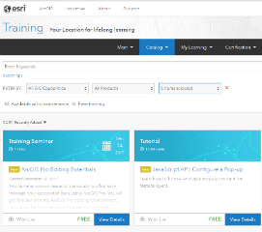
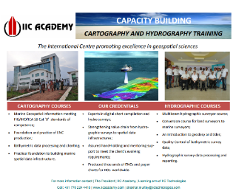
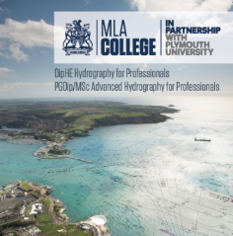
Accessing knowledge
Training and education
Selection of
Notes:
There is a whole host of different training courses available ranging from short introductory courses to 30 week comprehensive technical programmes. Post graduate programmes in Hydrography or Ocean Sciences are also an option if you want to progress your academic knowledge and qualifications even further.

Slide 8
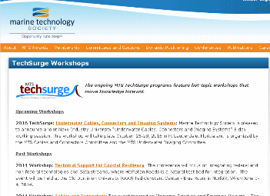
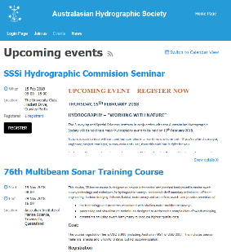
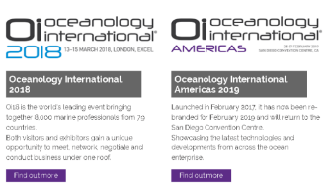
Accessing knowledge
Events, conferences, exhibitions
http://ushydro2017.thsoa.org/conference-proceedings/
Notes:
Events, conferences and exhibitions are a good way to gain CPD – details are often listed via newsletters such as Ocean Buzz or through the websites such as hydro-international.com.
Some conferences freely publish the papers and presentations after the conference which you can access online – a good example is US Hydro 2017 where the presentations and papers are free to download even if you were not able to attend the conference.

Slide 9
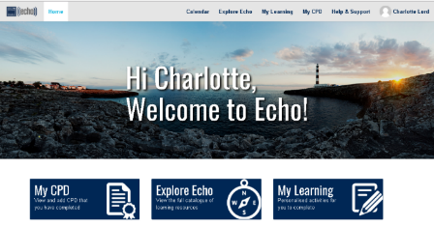
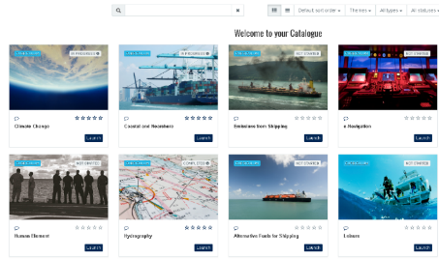
Accessing knowledge
Professional membership organisations and networks
Offer members CPD opportunities
E.g. events, publications, technical working groups, training courses
2. Provide a professional network
many have local chapters or branches or have technical working groups for members
3. Provide external recognition and validation of career development
Some offer different membership levels and/or offer professional qualifications or certification depending on your skills and experience
Notes:
Professional societies and networks can provide members with direct access to CPD opportunities as well as providing a network of like minded people who share the same professional interests.
This is an example of the IMarEST’s CPD tool for it’s members. It offers their members a single platform to access a library of CPD learning such as lecture recordings, videos of conferences, technical papers, industry magazines.

Slide 10
Accessing knowledge
Professional membership organisations and networks
Examples of professional membership organisations:
The Institute of Marine Engineering, Science & Technology (IMarEST)
International Federation of Hydrographic Societies (Australasia and United Kingdom chapters)
Royal Institution of Chartered Surveyors (RICs)
Society for Underwater Technology (SUT)
World Ocean Council
Society of Naval Architects and Marine Engineers (SNAME)
Chartered Institution of Civil Engineering Surveyors (ICES)
The Marine Technology Society (MTS)
Notes:
There are a number of different organisations to choose from offering a range of benefits for their members.

Slide 11
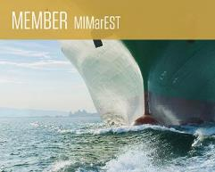
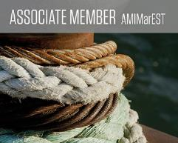
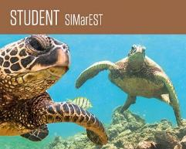
Professional recognition
A membership level to reflect your skills and experience
Example of the different levels of that IMarEST membership offers
Members use post nominals to demonstrate they’ve achieved this level.
For example
“John Doe, MIMarEST”
Notes:
Many professional societies offer different levels of membership. This gives individuals the opportunity to gain a higher grade of membership as their career progress which provides an external validation and recognition of their experience and skills.

Slide 12
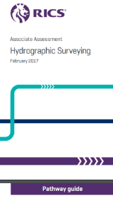
Professional recognition
Professional certification and qualifications for individuals
Professional standards of competence for individuals
Typically awarded to individuals with 5 years experience plus demonstration of knowledge, skills, abilities and behaviours
Assessments typically through written application, interviews or written examination
Individuals must demonstrate ongoing CPD to retain qualifications
Benefits individuals, organisations & society
Notes:
There are a number of professional certifications or qualifications available for hydrographers. A professional qualification demonstrates an individuals competence and experience (the highest level being that of ‘Chartered’ status) and, as it is assessed on the same criteria worldwide, they ensure that the same high professional standards are reached across all continents, allowing the individual hydrographer to be recognized as a trusted professional, wherever they are in the world.

Slide 13
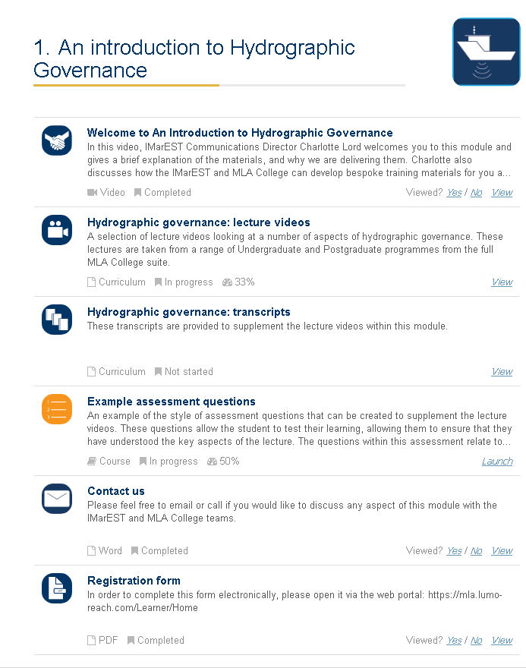
Free e-learning bundle
‘An introduction to Hydrographic Governance’
What is it?
A ‘bundle’ of e-learning material to complement the workshop
We are giving you free access to the e-learning platform
You can access the platform online or download app for Apple & Android
Receive free access using the sign-up sheet
Selection of
Notes:
We’ve give you access to an e-learning platform and have provided you with a ‘bundle’ of free e-learning on topics we think will be useful to you.

Slide 14
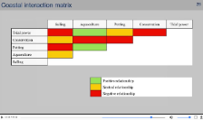
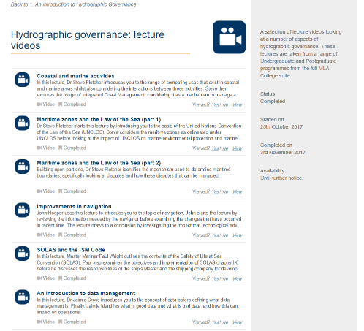
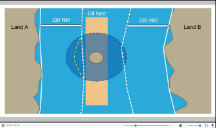
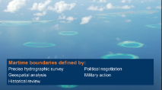
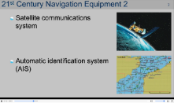
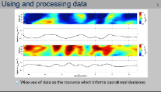
Topics
6 lecture videos on various topics
Notes:
There are 6 lecture videos covering a variety of topics including:
Safety of Life at Sea (SOLAS) and International Safety Management (ISM)
Improvements in Navigation
Maritime Zones part A
Maritime Zones part B
Coastal and Marine Activities
Introduction to Data Management

Slide 15
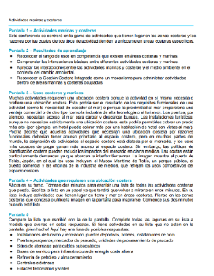
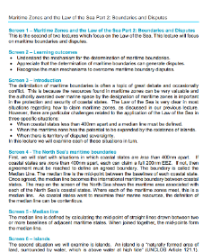
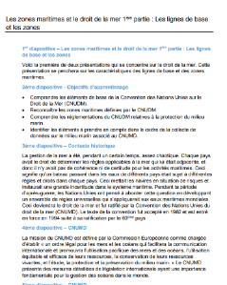
Learning tools
Lecture videos, maritime zones quiz and lecture transcripts
Notes:
The platform contains a welcome video and 2 ½ hours of video learning
It includes written lecture transcripts in English & Spanish (and one in French)
You can download the lectures and transcripts to view without internet connection
You can test your knowledge with Quiz on Maritime Zones

Slide 16
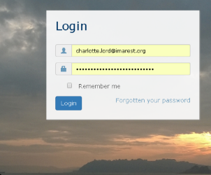
Steps to access
Step 1: Go to mla.lumo-reach.com/Learner/Home
and use the login details provided to you
Step 3: Click on content to view
3.
1.
Step 2: Click on
‘An Introduction to Hydrographic Governance’ module
2.
Notes:
Get learning in 3 easy steps. Please leave your name and email contact details with me for enrolment.

