Slide 1
IHO SWPHC Technical Workshop on Implementing Hydrographic Governance
Nadi, Fiji - 20th February 2018
IHO SWPHC Technical Workshop on Implementing Hydrographic Governance
SPC
Salesh Kumar, Hydrographic Surveyor

Slide 2
Contents
Overview of SPC
Work areas of SPC
Data collection, processing and management
Donor funding

Slide 3
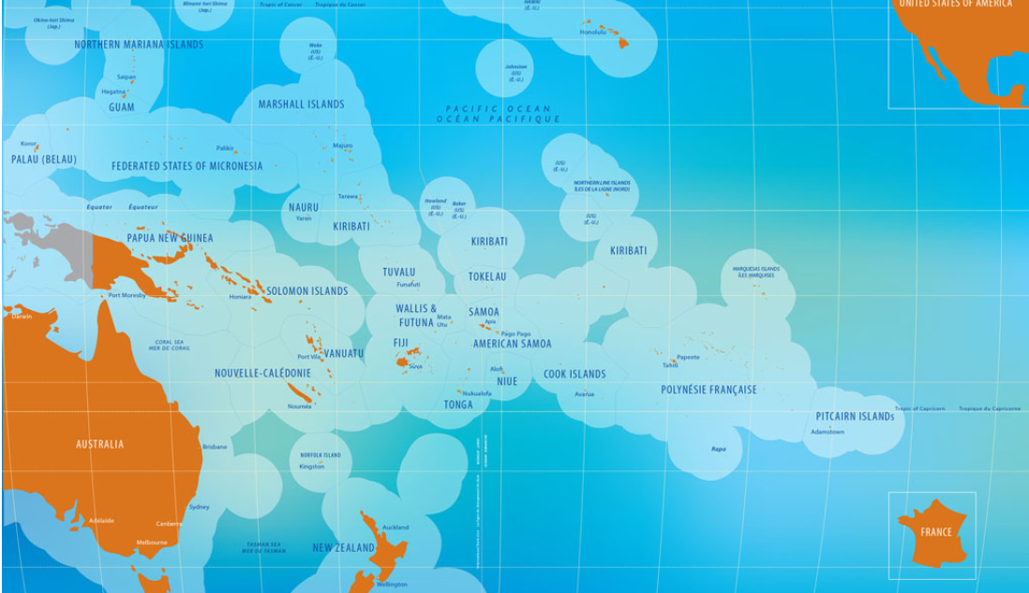
The Pacific Community Members
26 Member Countries and Territories 600 staff 10 Sectors USD 100 million
Notes:
As the Pacific’s first regional organisation, SPC is often seen as having the broadest mandate. SPC’s Pacific Community Strategic Plan 2016–2020 describes SPC as the ‘principal scientific and technical organisation supporting development in the Pacific Region’. The Secretariat of the Pacific Community (SPC)

Slide 4
The Pacific Community
Notes:
WHAT WE DO
Climate Change and Sustainability Economic Development Educational Quality & Assessment Fisheries, Aquaculture & Marine Ecosystems Geoscience Human Rights – RRRT Land Resources Public Health Social Development Statistics for Development
As the Pacific’s first regional organisation, SPC is often seen as having the broadest mandate. SPC’s Pacific Community Strategic Plan 2016–2020 describes SPC as the ‘principal scientific and technical organisation supporting development in the Pacific Region’. The Secretariat of the Pacific Community (SPC)
26 Member Countries and Territories 600 staff 14 Sectors USD 100 million

Slide 5
What we do

Slide 6
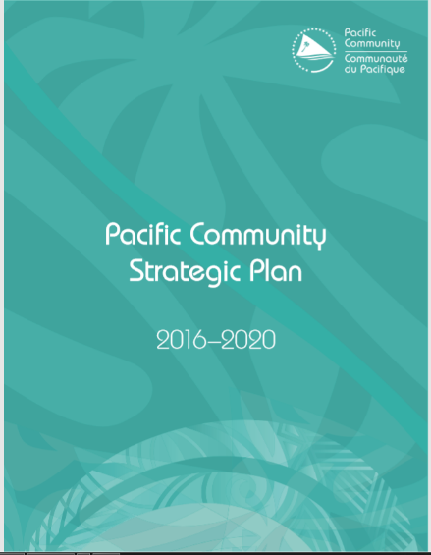
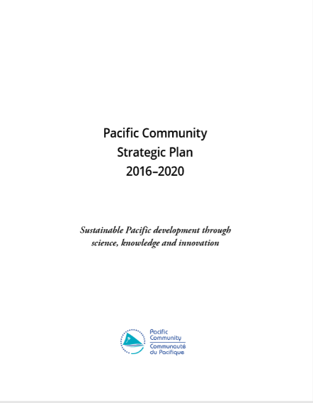
The Pacific Community Strategic Plan 2016–2020 sets out our organisation’s strategic direction and priorities.
Notes:
This plan expresses our resolve to enhance our performance by focusing on the quality of our expertise, the effectiveness of our interventions, the strength of our partnerships, and on innovation.
Our work will be underpinned by our deep knowledge and experience of the Pacific and of our members’ social, environmental and economic contexts. We will collaborate across our sectoral specialties to generate a dynamic interplay of capabilities, leading to creative approaches to development challenges. We will mobilise the skills, resources and action of partners, utilising and strengthening the existing regional mechanisms to pragmatically address the critical development challenges facing Pacific Island countries and territories (PICTs). We will assist our members to have their voices heard at regional and global levels, and our activities will reflect regional and global trends.

Slide 7
Environmental degradation, climate change and disasters threaten Pacific economies, livelihoods and cultures, and impact a range of sectors, including natural resources, agriculture, food security, education, public health and infrastructure.
Responding to disasters means that resources must be diverted to humanitarian assistance and recovery, potentially interrupting development progress. Some Pacific Island countries and territories experience among the highest average annual disaster losses, as a percentage of GDP, in the world.
These challenges affect the Pacific region’s capacity to alleviate and prevent poverty, achieve sustainable development and help people realise their human rights and reach their potential. Responses to these challenges require regional cooperation, political leadership and effective alignment of support from development partners, and must be informed by members’ needs and a deep understanding of context. Effective solutions must be based on multi-sectoral responses aligned to national priorities, and the application of high-quality scientific and technical knowledge and innovation.
Notes:
TC Pam (2014), Vanuatu, Kiribati and Tuvalu
TC (2016)Winston, Fiji
TC Gita(2018), Tonga

Slide 8
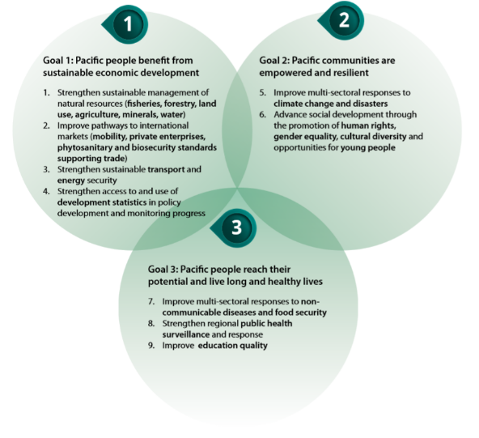
Development goals of the Pacific Community members SPC contributes to the following development goals
Notes:
Through its secretariat, the Pacific Community provides multi-sectoral contributions to the achievement of its members’ development goals.

Slide 9
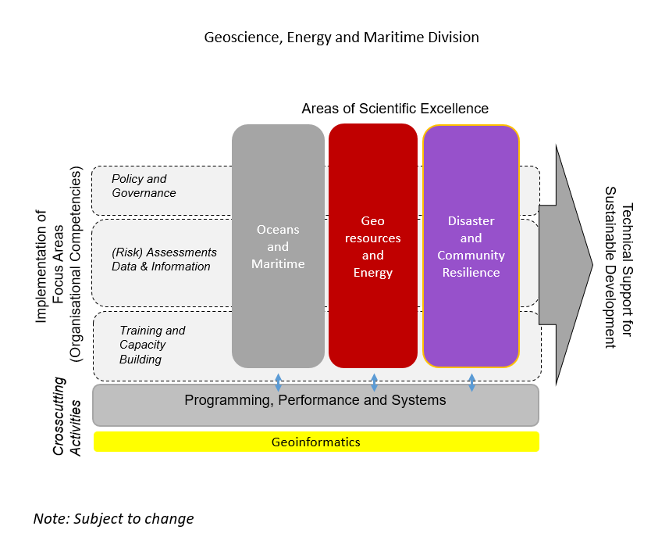
IHO SWPHC Technical Workshop on Implementing Hydrographic Governance
GEM Division
Notes:
In 2017, the GeoScience, Energy and Maritime (GEM) Division was formed through a merger of the SPC Economic Development Division (EDD) and the Geosciences Division (GSD). The merger was facilitated with the aim of achieving an integrated programmatic approach of SPC services that will provide its members with high quality applied science and knowledge for evidence-based policy-making and technical solutions for improved governance, management and capacity development. The newly formed GEM division has 3 Key Program Pillars which includes a Oceans and Maritime Programme, GeoResources and Energy Programme and a Disaster and Community Resilience Programme. A Programming, Performance and Systems Unit will support these three technical and scientific programmes. The objectives and results of these programmes will be reflected in a GEM Business Plan (2018-2020) which will aligned to the SPC Strategic Plan.

Slide 10
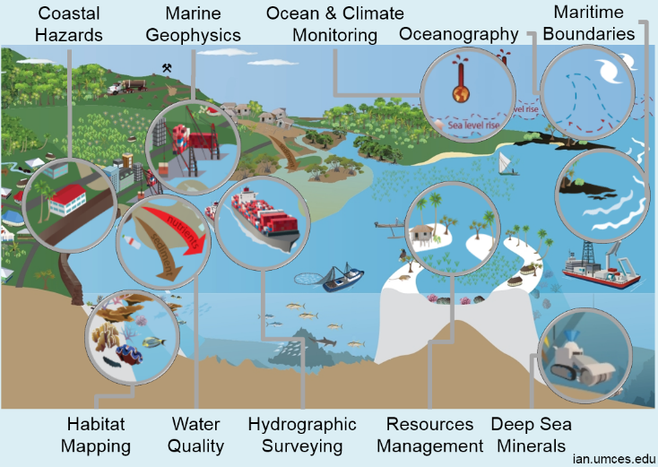
Work Areas at SPC (GEM Division)
Notes:
WHAT WE DO
climate change and sustainability
economic development
educational quality & assessment
fisheries, aquaculture & marine ecosystems
geoscience
human rights – rrrt
land resources
public health
social development
statistics for development

Slide 11
Data Collection Equipment
Hydrography
Multibeam (R2Sonic 2024 shallow water < 400m, Reson 8160 deep water <2000m)
MBES Mounting (Universal Sonar Mount(USM)
Single beam (Echotrach CVM dual frequency 200kHz and 24 kHz)
Tide gauges ( Valeport Tidemaster, Tide and Wave Recorders(TWR))
Position and heading (POS MV 320, Fugro Marinestar G2 Corrections, Trimble R10 GNSS GPS, SPS 852)
Levelling (Leica spirit level and Total stations)
Topography
Unmanned Aerial Vehicles (UAV’s), Trimble UX5HP fixed wing and DJI M210 quad copter)

Slide 12
Data acquisition and processing software (Hydrography)
Caris HIPS and SIPS – MBES and SBES data processing
HYPACK – MBES and SBES data acquisition and processing
Additional software's for data processing and visualisation
Surfer,
Global Mapper
Fledermaus
QGIS
Arc GIS

Slide 13
Data acquisition and processing software (Topography)
Trimble Business centre(TBC)
- Geodetic data processing
- UAV UX5 HP data collection and processing
Pix4D
- UAV M210 data processing
- DJI Pro – data collection (flight planning)
Global Mapper
QGIS

Slide 14
Data Management
All data collected by SPC in its member countries are stored on their behalf at SPC onsite and also backed up offshore.
All data is available to member countries and others that may be interested through proper requests through its member countries facilitated by SPC
eg. The PRNI project, all hydrographic data collected by SPC have been assessed to be of hydrographic importance will be passed on the PCA’s for charting purposes. This will be available on line for the PCA’s and PICTs.

Slide 15
http://www.pacgeo.org/prni/

Slide 16
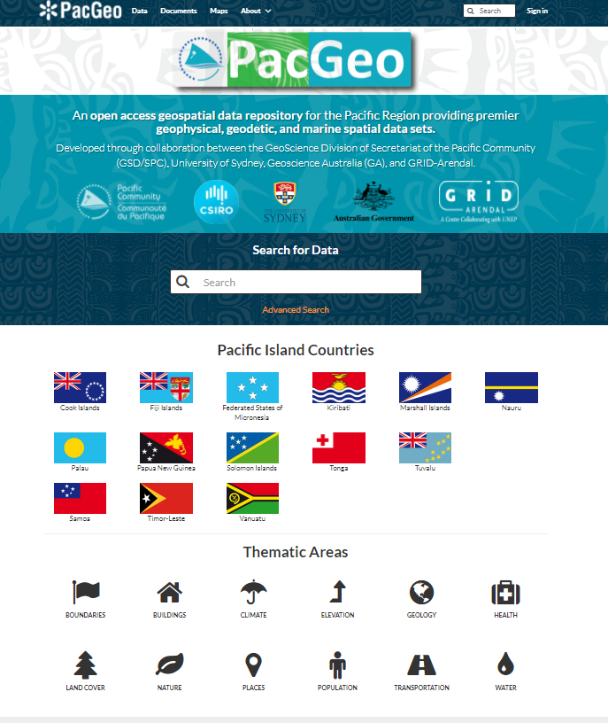

Slide 18
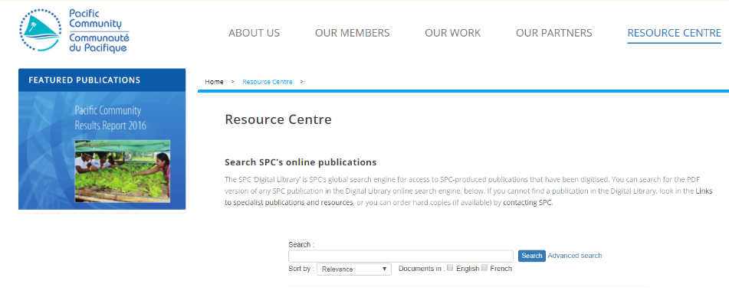
http://www.spc.int/resource-centre/

Slide 19
International development Partners/Projects
The Pacific Community (SPC) works with a variety of partners to support our members to achieve their development goals through scientific and technical assistance.
CROP Family
The Pacific Community (SPC) is one of nine Council of Regional Organisations in the Pacific (CROP) agencies. We enjoy close ties with fellow CROP agencies, collaborating on technical and scientific work across different sectors and on key cross-cutting issues such as climate change mitigation and adaptation, disaster risk resilience, sustainable oceans management, education, sustainable tourism and culture preservation to name a few.

Slide 20
CROP Family
Pacific Aviation Safety Office (PASO)
Pacific Islands Development Programme (PIDP)
Pacific Islands Forum Fisheries Agency (FFA)
Pacific Islands Forum Secretariat (PIFS)
Pacific Power Association (PPA)
Secretariat of the Pacific Regional Environmental Programme (SPREP)
South Pacififc Tourism Organisation (SPTO)
University of the South Pacific (USP)
Notes:
The Pacific Community (SPC) is one of nine Council of Regional Organisations in the Pacific (CROP) agencies. We enjoy close ties with fellow CROP agencies, collaborating on technical and scientific work across different sectors and on key cross-cutting issues such as climate change mitigation and adaptation, disaster risk resilience, sustainable oceans management, education, sustainable tourism and culture preservation to name a few.

Slide 21
Financial Support from Donors SPC Funding
Core budget support
-Untagged and available for all executive, corporate, administrative and program functions at SPC’s discretion.
Program Support
-This funding is tagged (or restricted) to support the implementation of individual divisions’ business plans.
Project Support
- This funding is tagged at the activity level, to support discrete and time bound areas of work undertaken by SPC divisions.
Notes:
Core budget mostly from AUS, NZ

Slide 22
Major Funding Partners

Slide 23
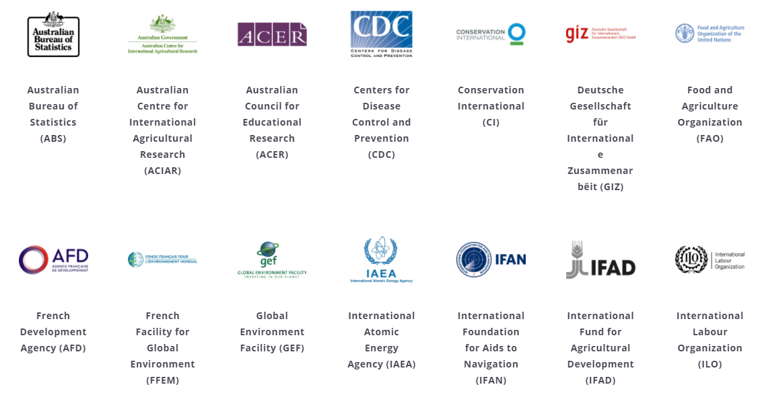
Main funding and knowledge partners

Slide 24
Main funding and knowledge partners
Interested in becoming an SPC Partner
Contact us to find out partnerships opportunities with SPC and contribute to the sustainable development of Pacific Island Countries and Territories and make a positive impact on the lives of Pacific people.
Notes:
Interested in becoming an SPC Partner
Contact us to find out partnerships opportunities with SPC and contribute to the sustainable development of Pacific Island Countries and Territories and make a positive impact on the lives of Pacific people.

Slide 25
Funding
How to write a good Project Proposal for Donor funding
Grant proposals are documents used to secure grant funds from institutional or private donors. Writing grant proposals requires specialized skills and experience that allow one to stand out from the wide range of other projects competing for limited grant funds.
At SPC we have a specialized position to deal with all aspects of funding:
Head of Fundraising
Hatice Anis
hatice@spc.int

Slide 26
Results achieved by the Pacific Community (SPC) in 2016 against the Pacific Community Strategic Plan 2016–2020

Slide 27
Vinaka

