Slide 1
Report on the Marine Spatial Data Infrastructures (MSDI)
(Adapted from the presentation made by the MSDIWG Chair to IRCC10)

Slide 2
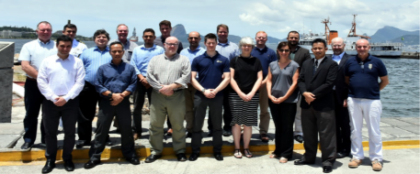
Principal activities and achievements
The MSDIWG9 meeting of took place in Niteroi (Rio de Janeiro), 30 January – 1 February 2018. The MSDIWG meeting was preceded firstly on 29 January by a MSDI Open Forum and after the MSDIWG9 meeting on the 2 February 2018 an OGC Marine Domain WG was arranged.

Slide 3
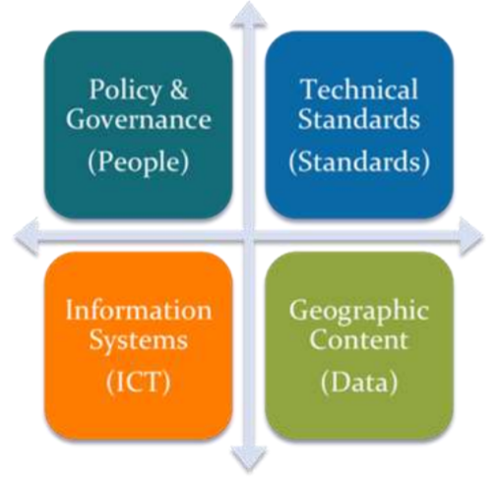
Principal activities and achievements
MSDIWG9 topics:
Information on MSDI implementation from MSDIWG members
IHO strategic plan and establishing a draft IHO MSDI vision 2025/2030
MSDI e-learning
Improving the availability of bathymetric data Worldwide
UN-GGIM and the marine domain
Security and integrity of data
The four basic components of MSDI

Slide 4
Principal activities and achievements
MSDIWG9 topics:
Update of C-17 (Edition 2)
The IHO/OGC conceptual study for a MSDI
Spatial Data Quality
Connection of S-100 with MSDI
Cooperation with the International Cable Protection Committee
Cooperation with OGC
Revision of the MSDIWG Work Plan
The four basic components of MSDI

Slide 5
Principal activities and achievements
Next Planned Meeting:
MSDIWG10
The IHO/MSDIWG will hold:
a three day-long MSDIWG10 meeting,
a one-day MSDI Open Forum, and
a one-day OGC Marine Domain WG meeting
in Busan, Republic of Korea, from 4 to 8 March 2019.
Logistics and meeting details will be available at: www.iho.int/msdiwg
Notes:
MSDI Open Forum
The IHO/MSDIWG will continue to facilitate a MSDI Open Forum which would allow non-MSDIWG stakeholders (e.g. RHC MS, government, academia, industry, funding bodies and NGOs) to attend to see what the MSDIWG and the commercial partners can offer. Attendees at the Open Forum would then be encouraged to stay on for the MSDIWG10 meeting. This approach is being developed in consultation with the hosts.
OGC Marine DWG
A joint meeting with OGC as the Co-Chairs of the Marine DWG are MSDIWG Members.

Slide 6
Principal activities of the Work Plan
A | Communication and dissemination
B | Operational - Data sharing and management
C | Policies and governances – Ensure that MSDI is a standing agenda item for RHCs’ meetings (IHO Res 2/1997, as amended, refers)
D | Standards (OGC and HSSC)
E | Innovation – Future perspectives (2021 - 2023)
F | Training and education
G | Maintain and extend the publication IHO MSDI C-17 (IHO Task 3.9.2.1 refers)
H | Conduct annual meetings of MSDIWG, arranged back to back with 1-day MSDI Open Forum (IHO Task 3.9.1 refers)

Slide 7

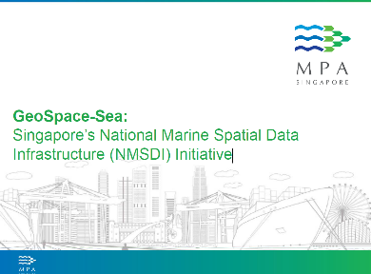
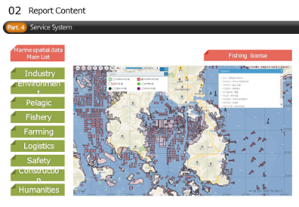
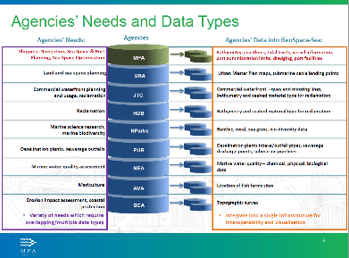
Principal activities and achievements
Information on MSDI implementation from MSDIWG members
Notes:
This will be part of the next generation C-17, an online live publication

Slide 8
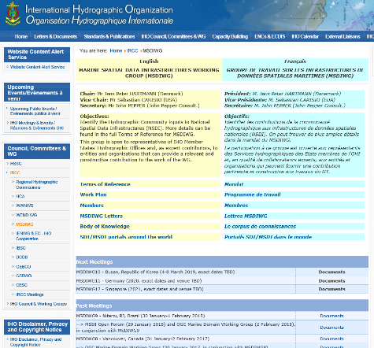
Principal activities and achievements
MSDI Body of Knowledge:
www.iho.int/msdiwg > Body of Knowledge
Notes:
How to access the page “Body of knowledge” that contains interesting references and MSDI material

Slide 9

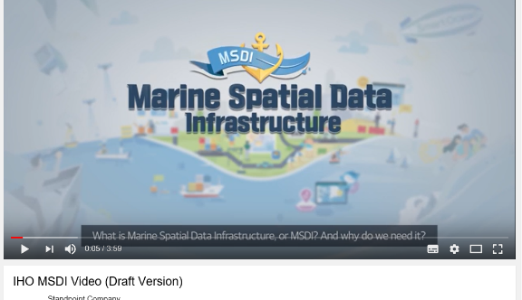

Principal activities and achievements
Communication and dissemination
Link to the video on MSDI

Slide 10
Security and Integrity
Security
  Unauthorised use (e.g stealing a car, downloading a pirate movie)
  To demonstrate “authorised use” some form of “permission” is required.
Integrity
  Who sent me this? Is it complete?
  Different from “is it correct?”
Different concepts.
In MSDI often integrity has a higher priority than security.
Why? Because often MSDI is built with the express purpose of promulgating data so most (not all) use is “authorised”
The conclusion we came to was the issue is “integrity” which relies on two things, knowing who a piece of data came from and the knowledge that it has not changed in its journey to the end user. This is also dealt with by IHO S-63 in the form of its digital signatures.

Slide 11
Security and Integrity - The issue within the MSDI community
Where are the risks?
Much MSDI data relates to boundaries, administrative, legal, cadastral etc.
Impact of incorrect reproduction or attribution can be very large.
Is there a ready-made solution?
Ongoing need to consider this issue
Consider existing mechanisms
  Stream based may not be suitable for “data centric” models
  IHO S-63 relies on a specific end user system
  Other standards exist but may need adaptation
  All require a “trust network” to define identitiy.
Notes:
Example Treaty Limit
Red is treaty

Slide 12
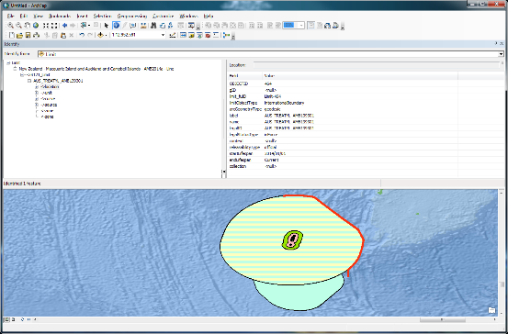
Security and Integrity - The issue within the MSDI community
Where are the risks?
Consider that one of the fundamental datasets recently under consideration are UNCLOS maritime limits and boundaries. These datasets are simple, by comparison with the complex geospatial data which make up ENC but their economic and political weight are enormous and the impact of their incorrect reproduction through an MSDI environment is of concern.
UNCLOS official limits and boundaries are often promulgated alongside other official boundaries such as marine protected areas, fishing zones and
many others which define rights and responsibilities as part of a harmonised marine cadastral system.
The challenge, technically, is to provide means and mechanisms to protect the data integrity and assure the end user of the provenance of the data they are receiving.
Notes:
Example Treaty Limit
Red is treaty

Slide 13
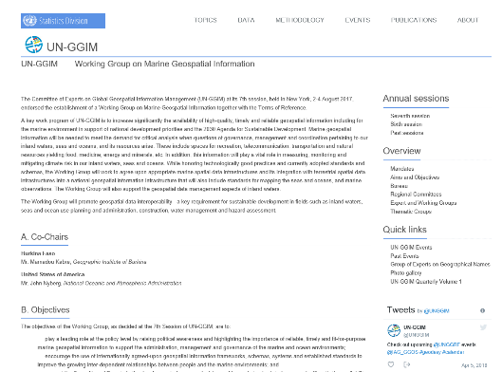
UN-GGIM - Working Group on Marine Geospatial Information
http://ggim.un.org/UNGGIM-wg8/ - Reference: IHO Circular Letter 47/2017
Notes:
Numerous Members of this WG are from Hydrographic Offices, including the Vice-Chair (John Nyberg, from USA).

Slide 14
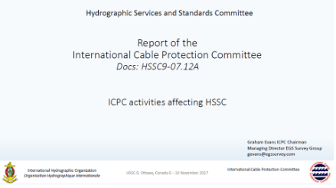

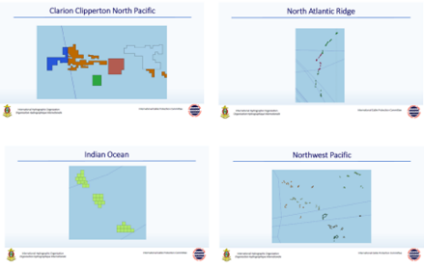
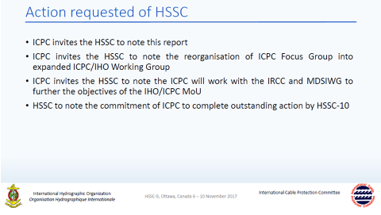
Cooperation with the International Cable Protection Committee

Slide 15
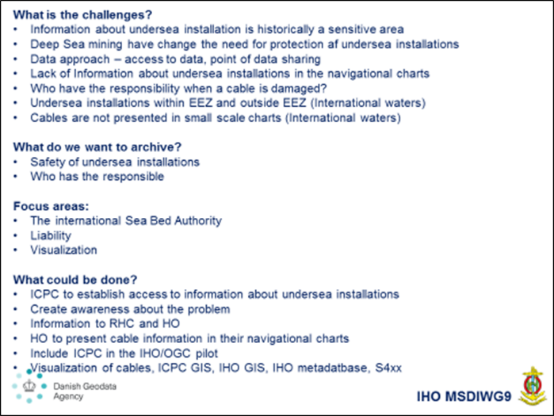
Cooperation with the International Cable Protection Committee

Slide 16
IHO MSDIWG Vision Statement (DRAFT)
The IHO MSDIWG vision is to enable open, accessible, and interoperable Marine Spatial data and information.
The broader use of MSDI will be able to connect people and systems.
This will create value, marine knowledge, and enhance decisions for the benefit of society, at any level of development, and sustain the environment.

Slide 17

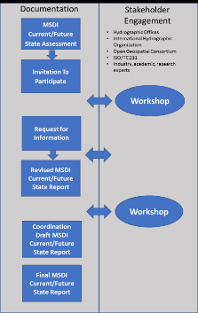
Future work program
Investigate the possibilities to establish an IHO Metadata platform for Hydrographic data?
Establish a MSDI e-learning platform
IHO OGC MSDI Concept
Development Study (CDS)

Slide 18
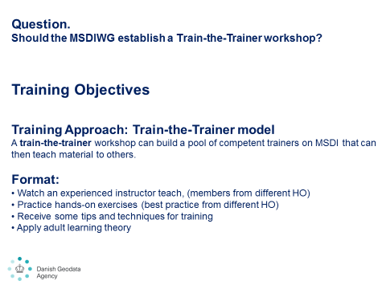
Future work program
Investigate the need and possibilities to use
S-58 and S-64 from a MSDI approach.
Establish a Train-the-Trainer workshop/training.

Slide 19
Decisions, actions and recommendations from IRCC10
OUTCOME OF IRCC10

Slide 20
Decisions, actions and recommendations from IRCC10
Decision 17: to task the MSDIWG to:
• follow the development in MSP implementation worldwide,
• establish a list of relevant MS National MSP Data Contact Points and contact persons,
• establish a list of additional relevant institutions, contact person/data experts,
• study the most relevant MSP issues in a cross-border / trans-boundary context in relation to data and information seen from a MS perspective,
• compile minimum requirements for Hydrographic data for Maritime Spatial Plan Data and recommendations of distribution/sharing of this data,
• provide an overview on (national / regional) MSP best practice,
• establish MSP page on the IHO website under the MSDIWG body of knowledge.

Slide 21
Decisions, actions and recommendations from IRCC10
Decision 18: to establish the IHO Project Team on the implementation of the UN-GGIM Shared Guiding Principles for Geospatial Information Management (PPT) under the ToR and RoP in doc. IRCC10-07E1.
Action 13: task the IHO Project Team on the implementation of the UN-GGIM Shared Guiding Principles for Geospatial Information Management (PPT) work under its ToR and RoP and to report back to IRCC (deadline: IRCC11).
Action 14: Secretariat to create a web page to present the work of the IHO Project Team on the implementation of the UN-GGIM Shared Guiding Principles for Geospatial Information Management (PPT) (deadline: July 2018).

Slide 22
Decisions, actions and recommendations from IRCC10
Action 10: MSDIWG to develop basic MSDI training material in order to allow RHCs to deliver trainings with their own personnel (deadline: IRCC11).

Slide 23
Decisions, actions and recommendations from IRCC10
Examples from other RHCs

Slide 24
Decisions, actions and recommendations from IRCC10
BSHC and NSHC:
  Baltic Sea North Sea Marine Spatial Data Infrastructure Working Group
ARHC:
  Arctic Regional Marine Spatial Data Infrastructures Working Group
  Arctic SDI
MACHC:
  Marine Economic Infrastructure Program (MEIP)
  Portal for GIS data
SDI/MSDI Portals: https://www.iho.int/gis/msdi.gis.html

Slide 25
Action requested of SWPHC16
The SWPHC16 is invited to:
note the importance of MSDI to support the objectives of the IHO
assign a MSDI Ambassador in the region (Action IRCC9/18)
to participate in the MSDIWG meetings and engage with its work
to note the examples of other RHCs on MSDI
discuss any item with relevance to SDI/MSDI and take appropriate actions

