Slide 1
16th Meeting of the South West Pacific Hydrographic Commission Technical Workshop on Disaster Response Planning and Data Discovery
International Hydrographic Organization
IHO Secretariat

Slide 2
Summary
Introduction
References
The need for hydrography
Uses and benefits
The meaning of inadequate hydrography
Who is responsible for hydrography
The IHO
Conclusion

Slide 3
Summary
Introduction
References
The need for hydrography
Uses and benefits
The meaning of inadequate hydrography
Who is responsible for hydrography
The IHO
Conclusion

Slide 4
Introduction
Hydrography is … the measurement and description of the physical features of oceans, seas, coastal areas, lakes and rivers … the prediction of their change over time, for … safety of navigation and in support of all other marine activities, … economic development, security and defense, scientific research, and environmental protection (S-32).

Slide 5
Introduction
Hydrography is not:
Nautical chart (a product)
Bathymetry (determination of depth)
Hydrography is an ensemble of activities from which data we can derive many different types of information, products, services

Slide 6
Summary
Introduction
References
The need for hydrography
Uses and benefits
The meaning of inadequate hydrography
Who is responsible for hydrography
The IHO
Conclusion

Slide 7
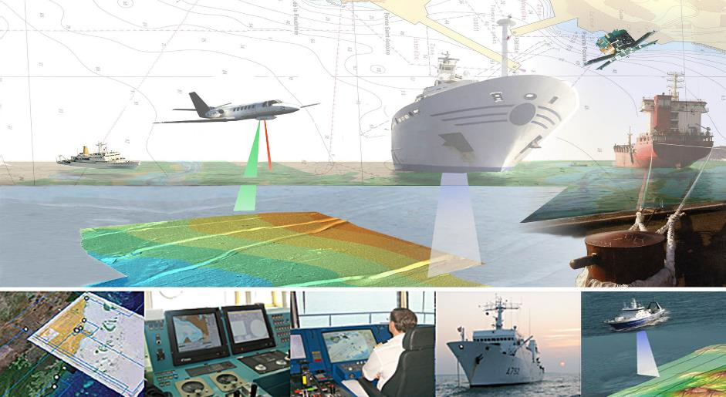
International Hydrographic Organization
Reference: Publication M-2 The Need for Hydrographic Services

Slide 8
International Hydrographic Organization
References
Downloads from the IHO website:
www.iho.int/downloads > M-2
www.iho.int > How to join the IHO to become a Member State
www.iho.int > Standards & Publications > IHO Presentations

Slide 9
Summary
Introduction
References
The need for hydrography
Uses and benefits
The meaning of inadequate hydrography
Who is responsible for hydrography
The IHO
Conclusion

Slide 10
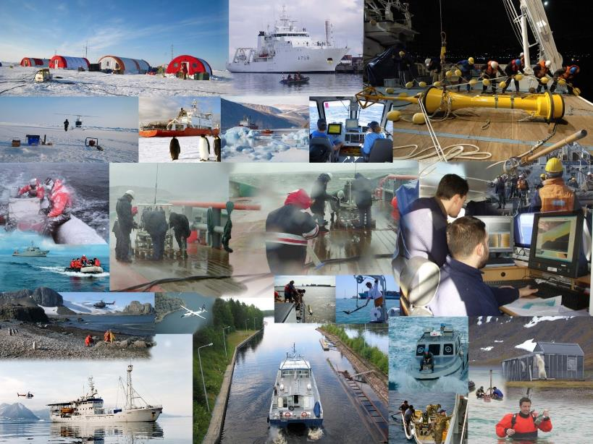
The need for hydrography

Slide 11
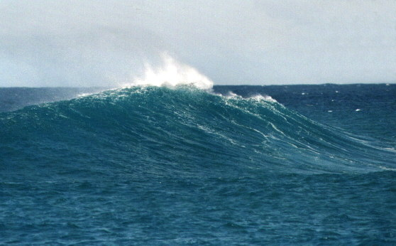
Hydrography provides the fundamental backdrop
The need for hydrography
for almost everything that happens in, on or under the sea

Slide 12
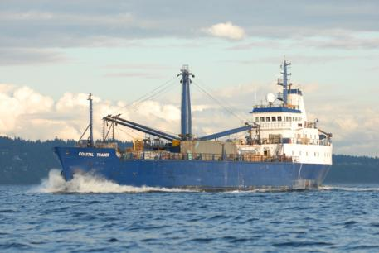
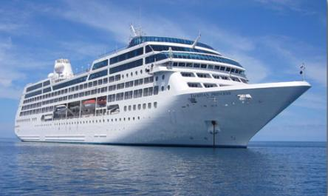
… without hydrography -
- no ship sails

Slide 13
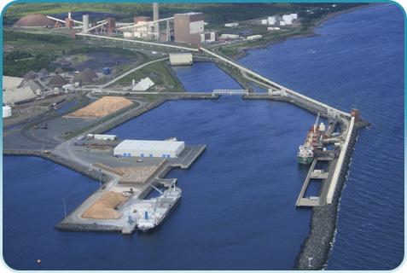
… without hydrography -
- no port is built

Slide 14
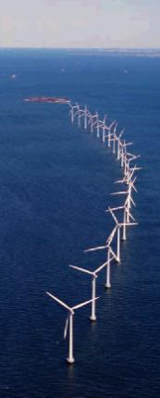
… without hydrography -
- no offshore infrastructure is developed

Slide 15
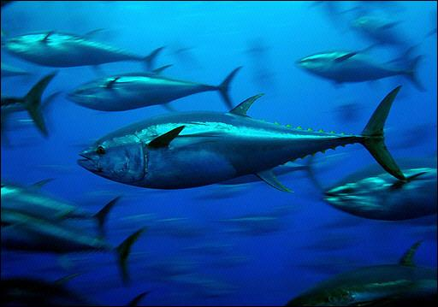
… without hydrography -
- no environmental plan is implemented

Slide 16
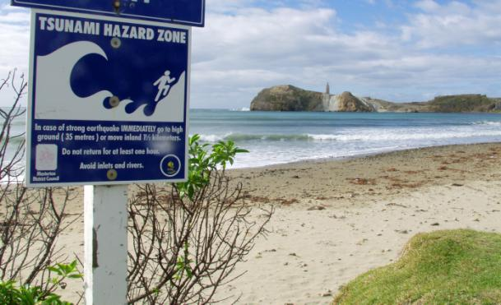
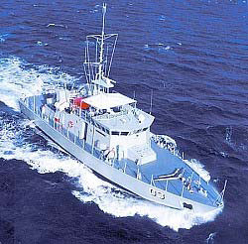
… without hydrography -
- no shore is defended, no island protected

Slide 17
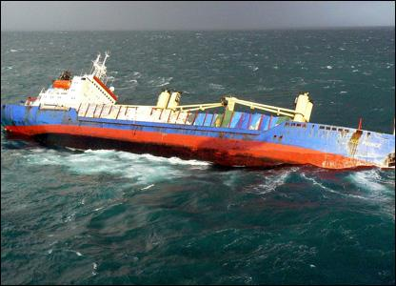
… without hydrography -
- no rescue is attempted

Slide 18
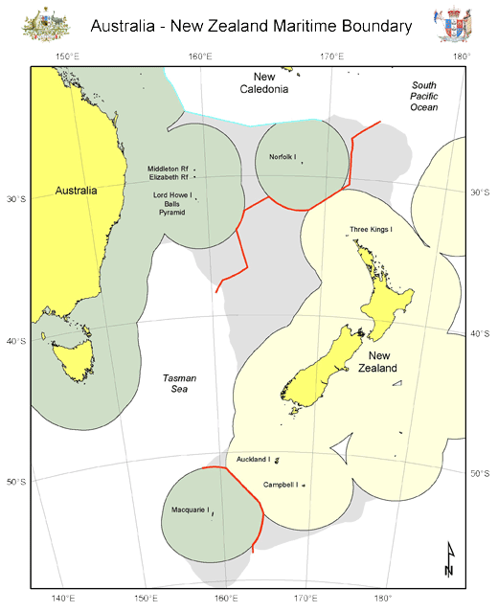
… without hydrography -
- no maritime boundary is delimited

Slide 19
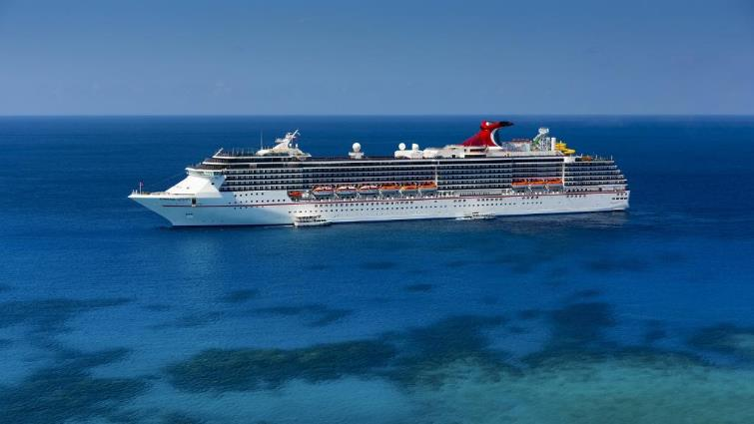
… without hydrography -
- no tourism is sustainable

Slide 20
Summary
Introduction
References
The need for hydrography
Uses and benefits
The meaning of inadequate hydrography
Who is responsible for hydrography
The IHO
Conclusion

Slide 21
Uses and benefits
Hydrography supports :
Safety of navigation
Protection of marine environment
National infrastructure development
Coastal zone management
Marine exploration
Resource exploitation – minerals, fishing
Maritime boundary delimitation (UNCLOS, others)
Maritime defence and security
Disaster management

Slide 22
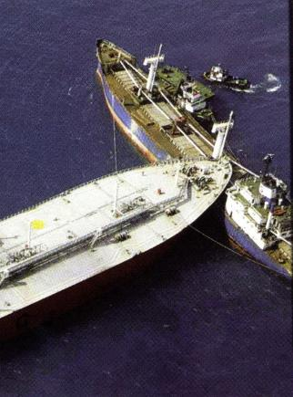
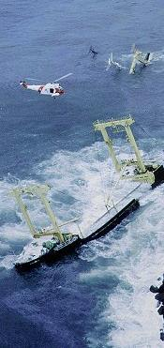
… Safety of Navigation

Slide 23
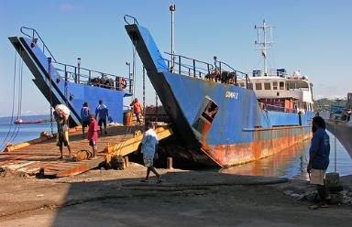
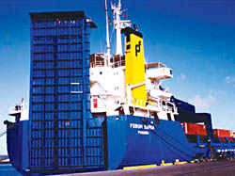
… Transport
>98% goods by volume

Slide 24
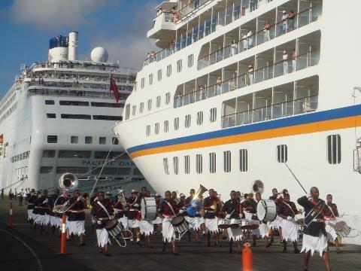
… Tourism
a growing market
larger ships
new destinations

Slide 25
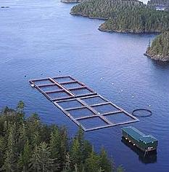
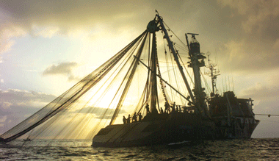
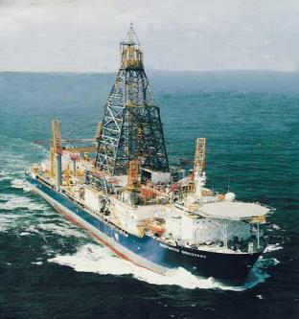
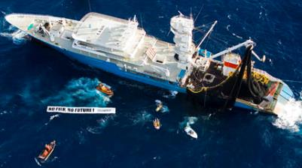
… Natural resources
fishing
seabed

Slide 26
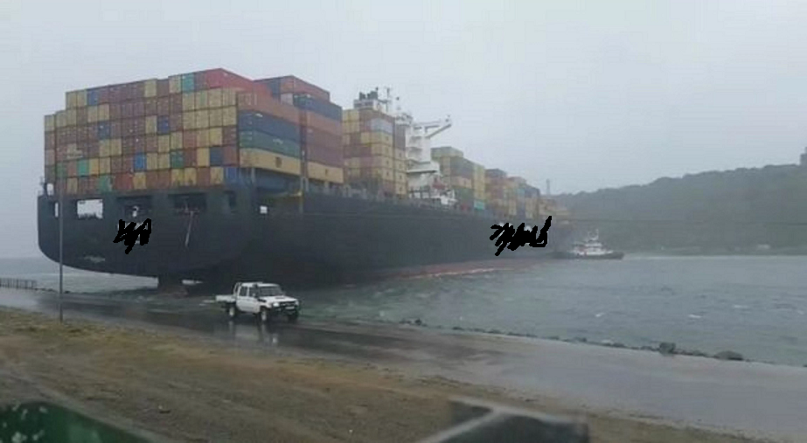
… Security and defence
Maritime patrol and military operations
Fishery protection
Surveillance
Disaster Relief
Search and Rescue(SAR)

Slide 27
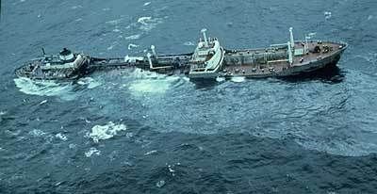
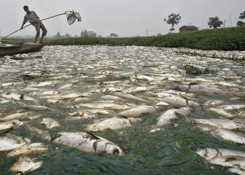
… Protection of the marine environment
dumping
oil spill
industrial pollution

Slide 28
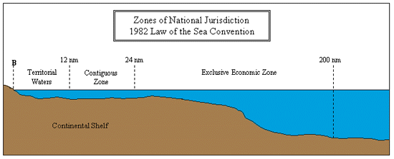
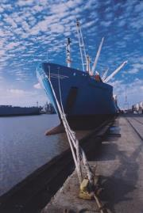
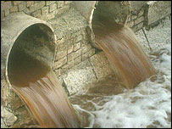
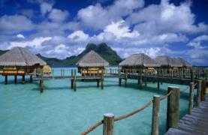
… Coastal zone management
resource management
industrial pollution
port development
areas of national jurisdiction

Slide 29
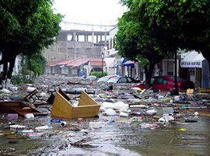
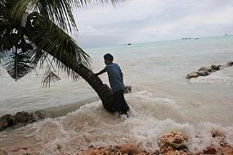
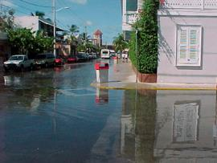
… Natural disaster management
inundation modelling
sea level monitoring
Tsunami forecasting
relief planning

Slide 30
Summary
Introduction
References
The need for hydrography
Uses and benefits
The meaning of inadequate hydrography
Who is responsible for hydrography
The IHO
Conclusion

Slide 31
The meaning of inadequate hydrography
Inadequate hydrography means:
risk of marine accidents increases
environmental pollution
loss of life
shipping lacks confidence in ports and routes
international trade is limited
missed economic opportunities
environmental impacts
potential liability and litigation

Slide 32
The meaning of inadequate hydrography
What is the cost of:
under-developed ports?
using complex and hazardous shipping routes?
lack of planning data for the coast and seas?
imprecise disaster planning models?
limited sea room for patrol vessels?

Slide 33
Wider use of hydrographic data
Marine Spatial Planning (MSP)
Integrated Coastal Zone Management (ICZM)
Strategic Environmental Assessment (SEA)
Shoreline Management Plans (SMP)
Emergency Response
Offshore Renewable Energy
Aggregates Extraction
Oil and Gas
Infrastructure Development (e.g. Ports and harbors)
Economic Development (e.g. Tourism)
E-Navigation

Slide 34
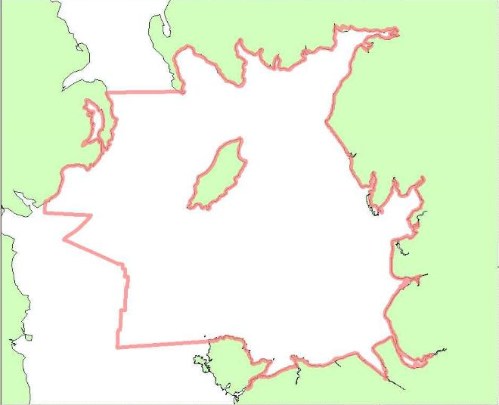
Marine Spatial Planning (MSP)
Irish Sea
Source: Defra Irish Sea Planning Pilot - 2006
Economic activity in the Irish Sea and coastal hinterland

Slide 35
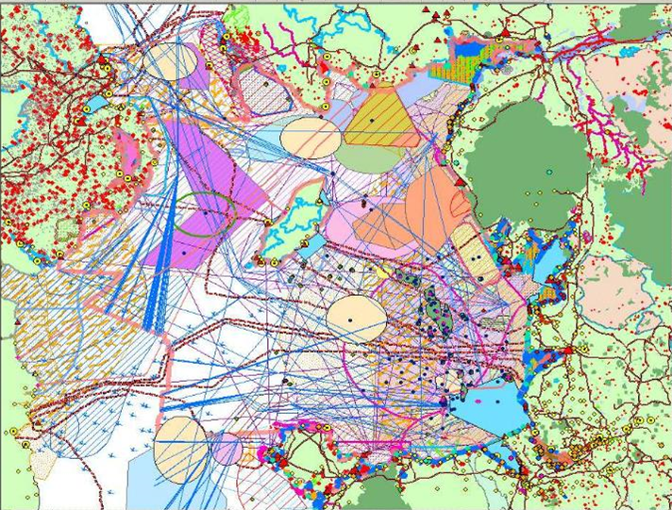
Marine Spatial Planning (MSP)
Land Use
Source: Defra Irish Sea Planning Pilot - 2006
Tourism
Oil &Gas
Mariculture
Coastal
Defence
Ports &
Navigation
Military
Activities
Culture
Conservation
Dredging &
Disposal
Submarine
Cables
Fishing
Renewable
Energy
Marine
Recreation
Mineral
Extraction

Slide 36
Summary
Introduction
References
The need for hydrography
Uses and benefits
The meaning of inadequate hydrography
Who is responsible for hydrography
The IHO
Conclusion

Slide 37
Who is responsible for Hydrography?
?

Slide 38
Who is responsible for Hydrography?
– Coastal States –
International Obligations

Slide 39
Mariners’ Obligations
Convention on the Safety of Life at Sea (SOLAS) Chapter V
SOLAS V/19 – Carriage requirements for Nav equipment
…shall carry nautical charts and publications …
…issued officially by or on the authority of a Government, authorized Hydrographic Office or other relevant government institution ….
… [adhering to] IHO specifications and guidelines
SOLAS V/27 – Nautical charts and nautical publications
…adequate and up to date

Slide 40
Governmental Obligations
SOLAS V/9 – provision of hydrographic services
Contracting governments undertake to arrange to collect and compile hydrographic data, and to publish, disseminate and update all nautical information necessary for safe navigation;
Obtain uniformity in charts and nautical publications and to take into account whenever possible the relevant international resolutions and recommendations, adopted by the IHO; and
Co-ordinate activities and ensure global availability of hydrographic and nautical publications

Slide 41
Governmental Obligations
SOLAS V/4 – navigational warnings
…take all steps necessary to ensure that, when intelligence of any dangers is received from whatever reliable source, it shall be promptly brought to the knowledge of those concerned and communicated to other interested Governments

Slide 42
SOLAS Chapter 5 regulations 9 and 4
This means each State must ensure that :
hydrographic surveys are carried out
appropriate nautical charts and other nautical publications are available and up to date
Maritime Safety Information (MSI) is promulgated

Slide 43
SOLAS Chapter 5 regulations 9 and 4
Provision of hydrographic services and navigational warnings:
… are International Obligations under Treaty Law
… apply to ALL Contracting Governments

Slide 44
Other Governmental Obligations
UN Resolution A.53/32 - The Year of the Oceans ….. invites States to cooperate in carrying out hydrographic surveys and in providing nautical services for the purpose of ensuring safe navigation as well as to ensure the greatest uniformity in charts and nautical publications and to coordinate their activities so that hydrography and nautical information is available on a world-wide scale

Slide 45
UNCLOS 1982
Charts are required to support:
Establishing baselines
Delimiting Sea Areas (Territorial Sea, EEZ, Continental Shelf, etc.)
Identifying traffic separation schemes
Identifying sea lanes transit and innocent passage routes
Deploying submarine cables and pipelines
Conducting drilling on the seafloor
Conduct of Marine Scientific Research

Slide 46
Meeting Governmental Obligations
SOLAS V/9 and V/4 can be satisfied:
directly via government
through bi-lateral agreement with other States
using commercial support providers
(in whole or in part)
Overall responsibility and obligation to ensure that a national hydrographic service is provided remains with the Government

Slide 47
Summary
Introduction
References
The need for hydrography
Uses and benefits
The meaning of inadequate hydrography
Who is responsible for hydrography
The IHO
Conclusion

Slide 48
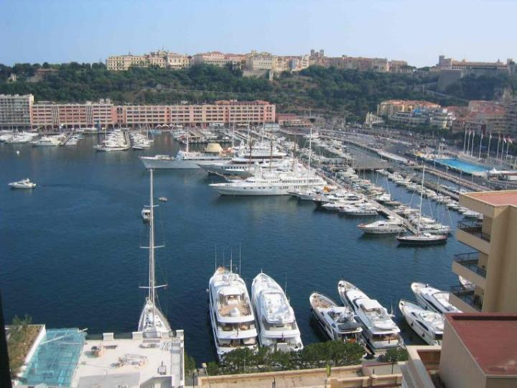
The IHO

Slide 49
The IHO
intergovernmental consultative and technical organization
established in 1921
to support safety of navigation and the protection of the marine environment

Slide 50
History of the IHO
1889 International Marine Conference, Washington, DC
1908 International Congress of Navigation, St Petersburg
1912 International Maritime Conference, St Petersburg
1919 International Hydrographic Conference, London
1921 IHB established by 18 nations in Monaco
1970 International Convention: established
2005 Protocol of Amendments to the IHO Convention
2016 Revised IHO Convention entered into force
2021 100 years of the IHO

Slide 51
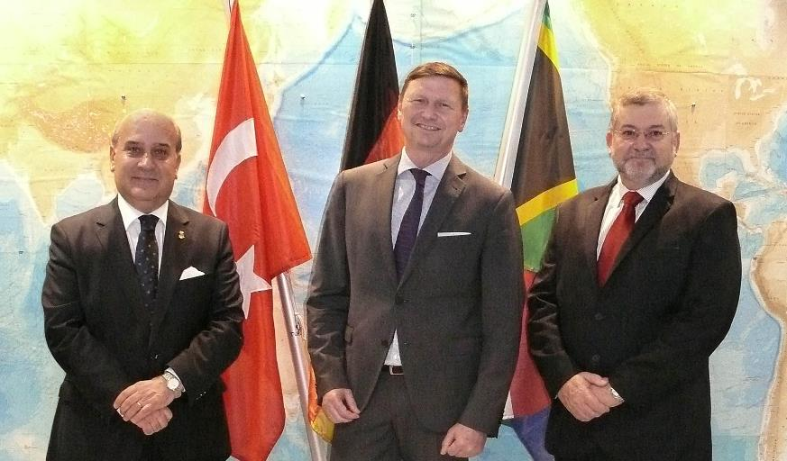
IHO Secretary-General and Directors

Slide 52
The IHO Secretariat Staff
20 Personnel
1 Secretary-General and 2 Directors
5 Professional Assistants
2 + 1 Translators
10 Supporting Staff
+ 3 Seconded Staff (Japan, Peru, ROK)

Slide 53
IHO ASSEMBLY
Finance Committee (FC)
IHO COUNCIL
IHO SECRETARIAT
(SECRETARY-GENERAL)
Hydrographic Services and Standards Committee (HSSC)
Inter-Regional Coordination Committee (IRCC)
Capacity Building Sub-Committee (CBSC)
Nautical Cartography WG
(NCWG)
Regional Hydrographic
Commissions (RHCs)
ENC Standards Maintenance WG
(ENCWG)
Sub-Committee on the Worldwide Navigational Warning Service (WWNWS-SC)
Nautical Information Provision WG (NIPWG)
Hydrographic Commission on Antarctica (HCA)
S-100 WG
Worldwide ENC Database WG
(WENDWG)
Data Quality WG (DQWG)
IHO Data Centre for Digital Bathymetry (DCDB)
Marine Spatial Data Infrastructure WG (MSDIWG)
Data Protection Scheme WG (DPSWG)
IHO-IOC General Bathymetric Chart of the Oceans (GEBCO)
Guiding Committee (GEBCO GC)
Tides, Water level and Current WG (TWCWG)
IHO-EU Network WG
(IENWG)
Hydrographic Dictionary WG (HDWG)
Technical Sub-Committee on Ocean Mapping (TSCOM)
Crowd-Sourced Bathymetry WG (CSBWG)
IHO-IAG Advisory Board on the Law of the Sea (ABLOS)
Sub-Committee on Regional Undersea Mapping (SCRUM)
FIG-IHO-ICA International Board on Standards of Competence for Hydrographic Surveyors and Nautical Cartographers (IBSC)
Sub-Committee on Undersea Feature Names (SCUFN)

Slide 54
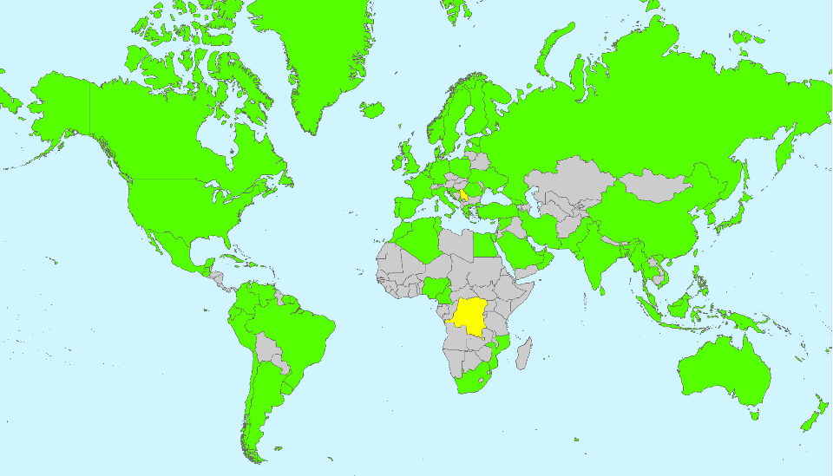
IHO Membership

Slide 55
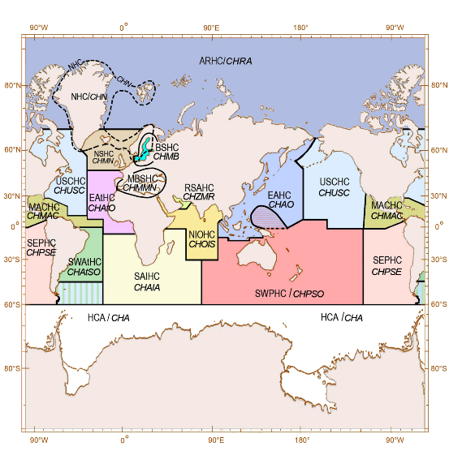
Regional Hydrographic Commissions
15 RHCs + Hydrographic Commission on Antarctica
Regional coordination of
charting schemes
capacity building and assistance
bilateral cooperation
technical cooperation
training

Slide 56
IHO Secretariat, here to help you! www.iho.int abri.kampfer@iho.int alberto.neves@iho.int

