Slide 1
16th Meeting of the South West Pacific Hydrographic Commission Technical Workshop on Disaster Response Planning and Data Discovery
Status of Surveys and MSI at the SWPHC

Slide 2
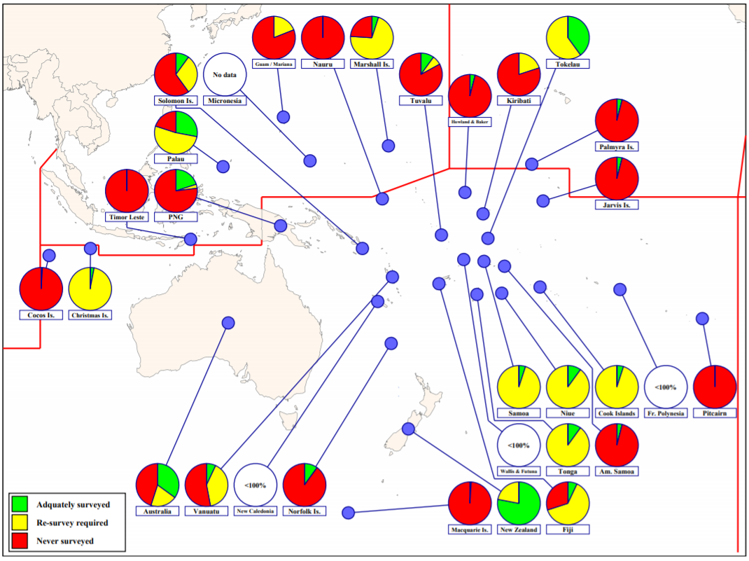
IHO Publication C-55
Survey coverage:
Depth < 200m

Slide 3
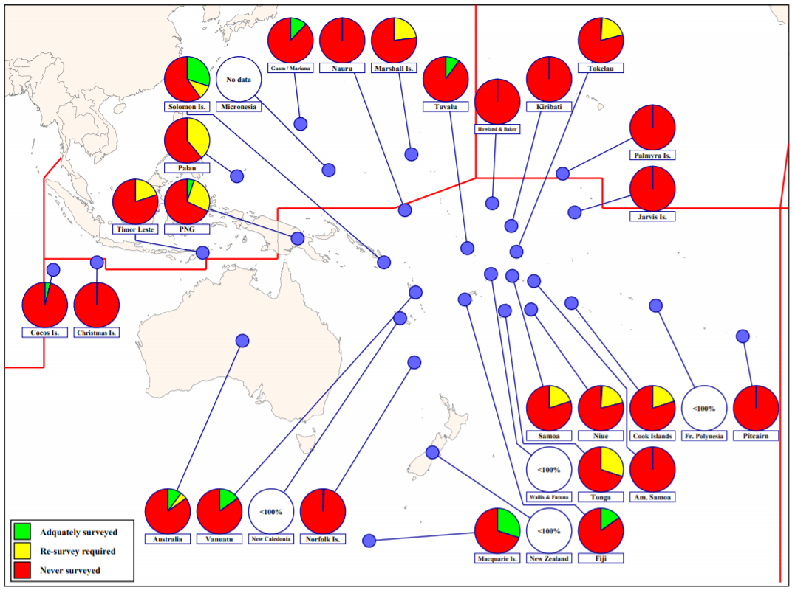
IHO Publication C-55
Survey coverage:
Depth > 200m

Slide 4
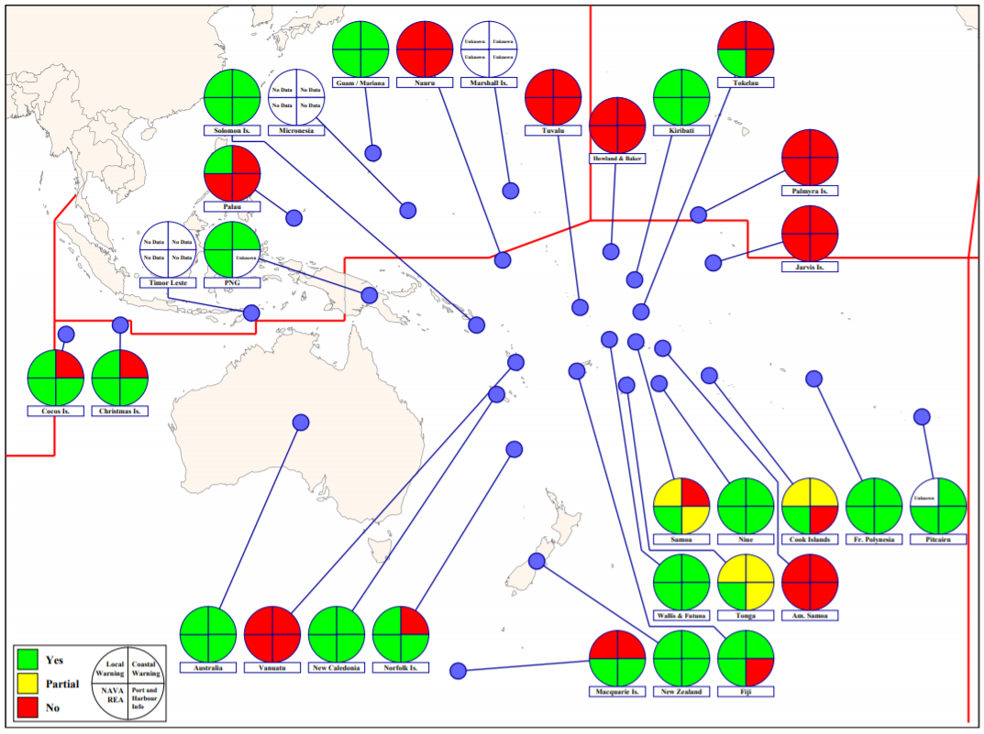
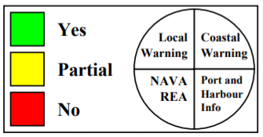
IHO Publication C-55
MSI:

Slide 5
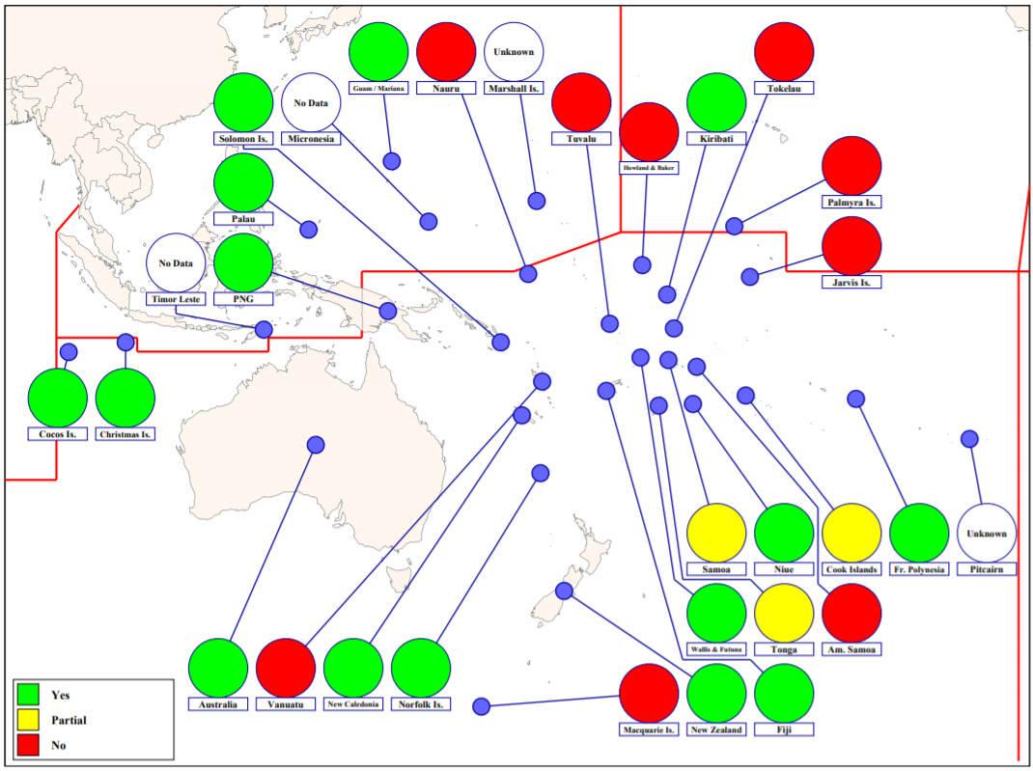
IHO Publication C-55
MSI Local Warnings

Slide 6
IHO Secretariat, here to help you! www.iho.int abri.kampfer@iho.int alberto.neves@iho.int

