Slide 1
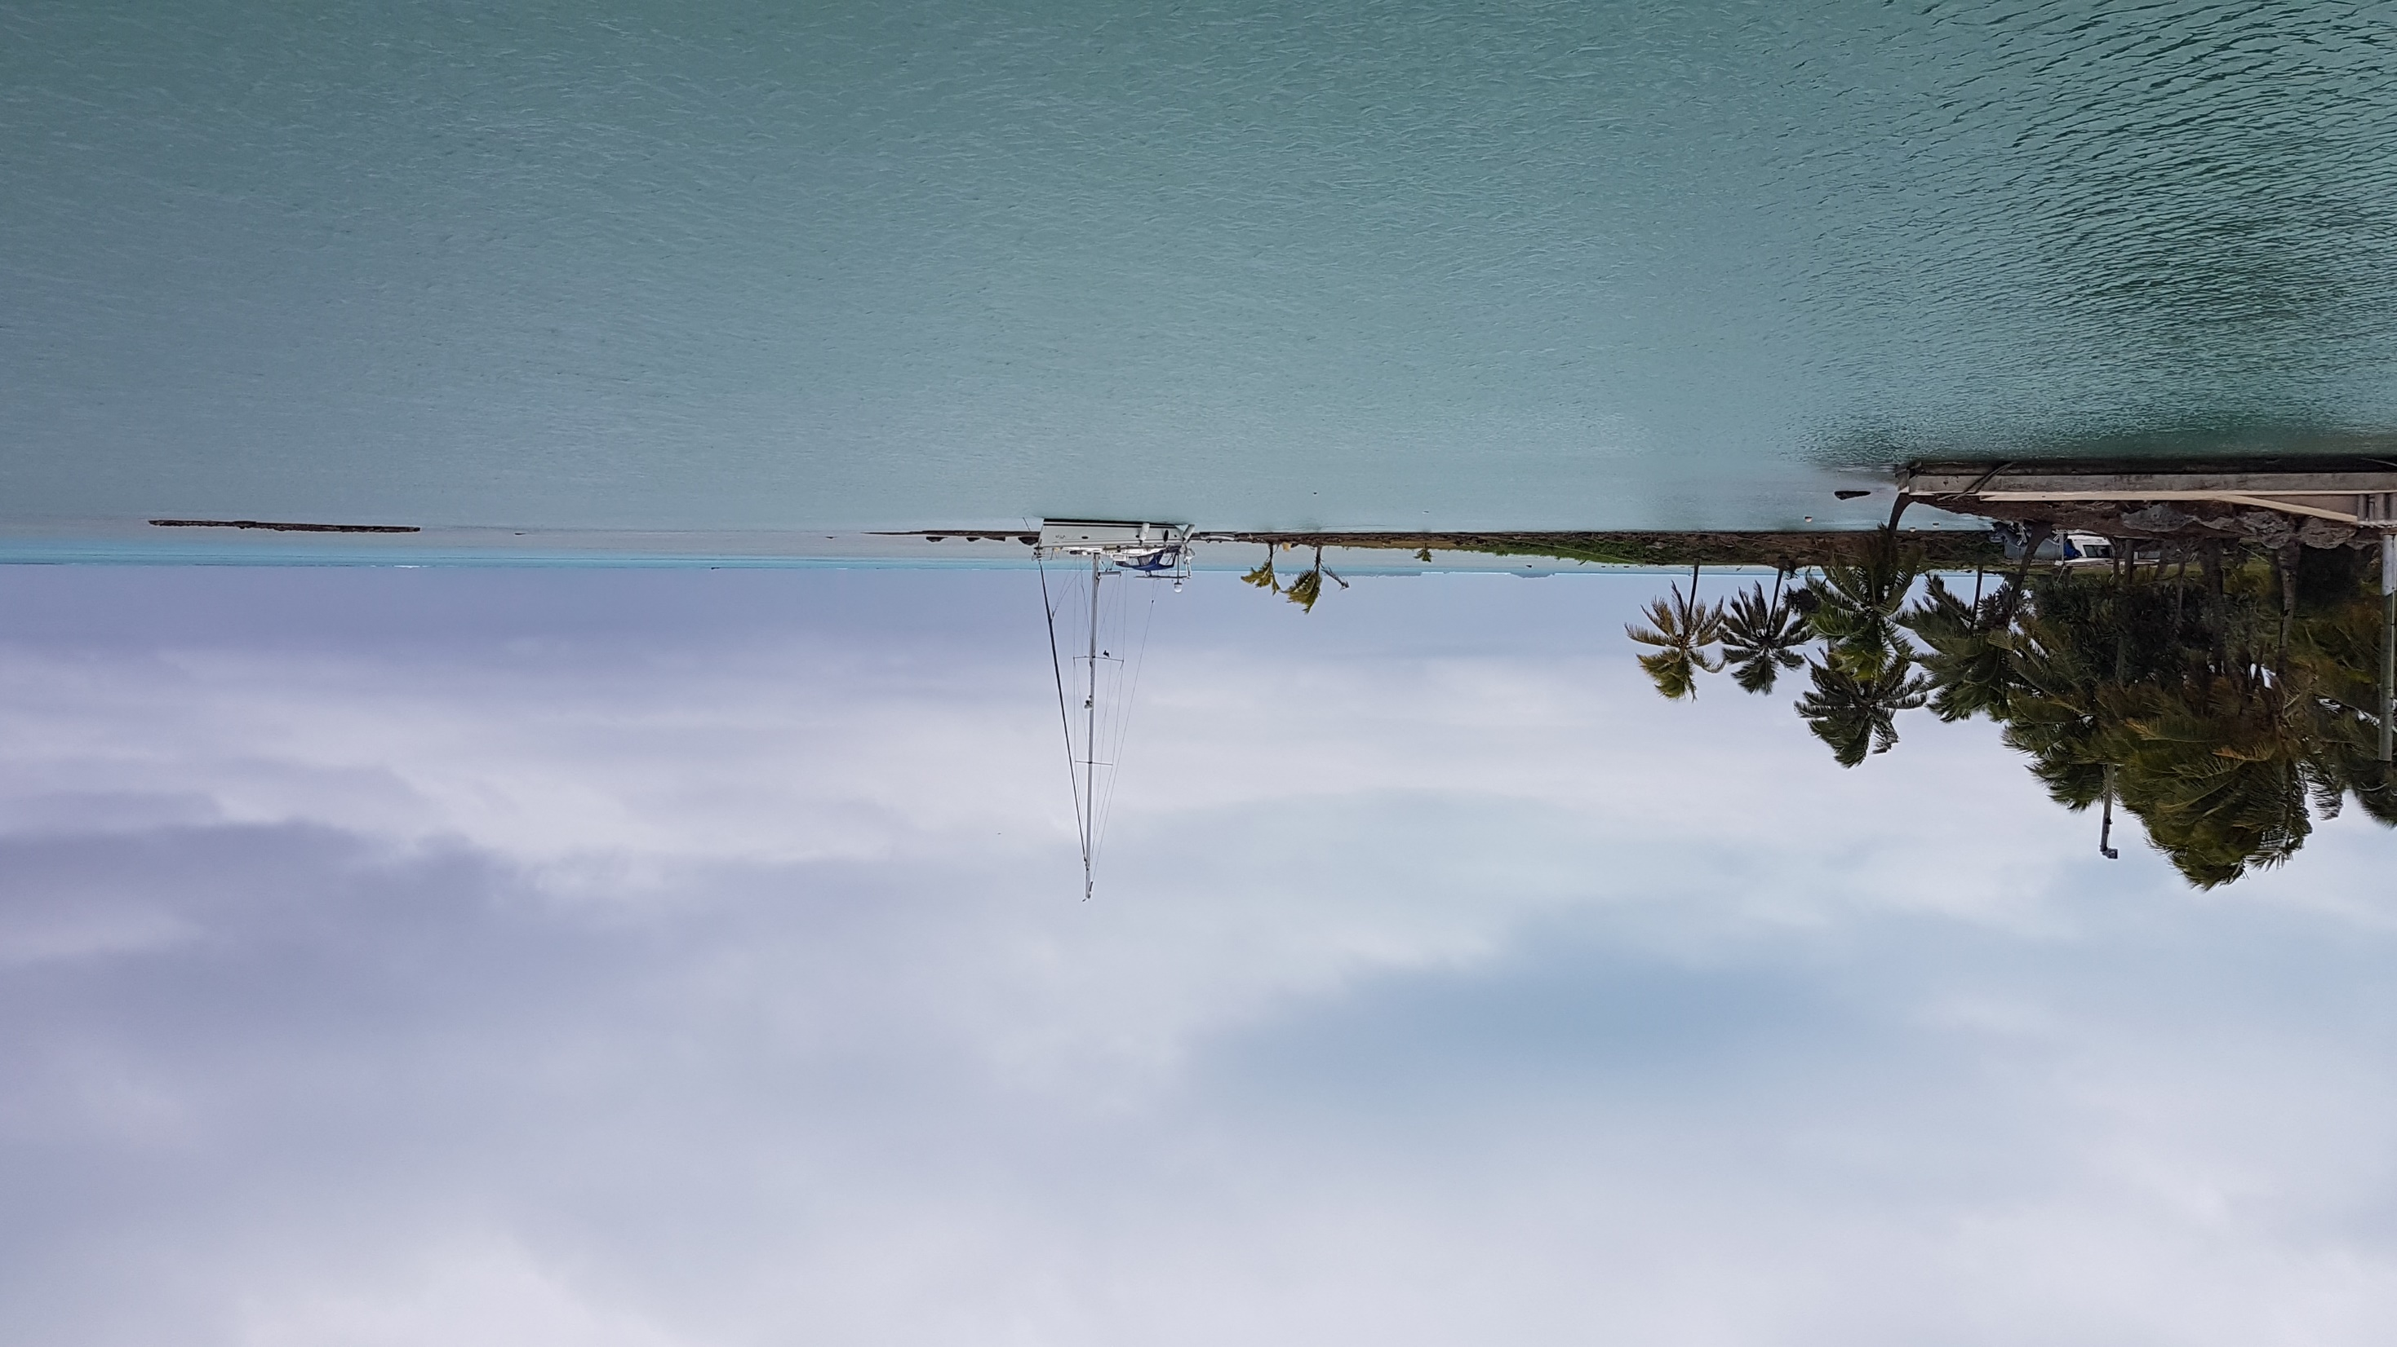
Geoscience, Energy and Maritime Division (GEM)
Data Discovery
Salesh Kumar, Hydrographic Surveyor
saleshk@spc.int

Slide 2
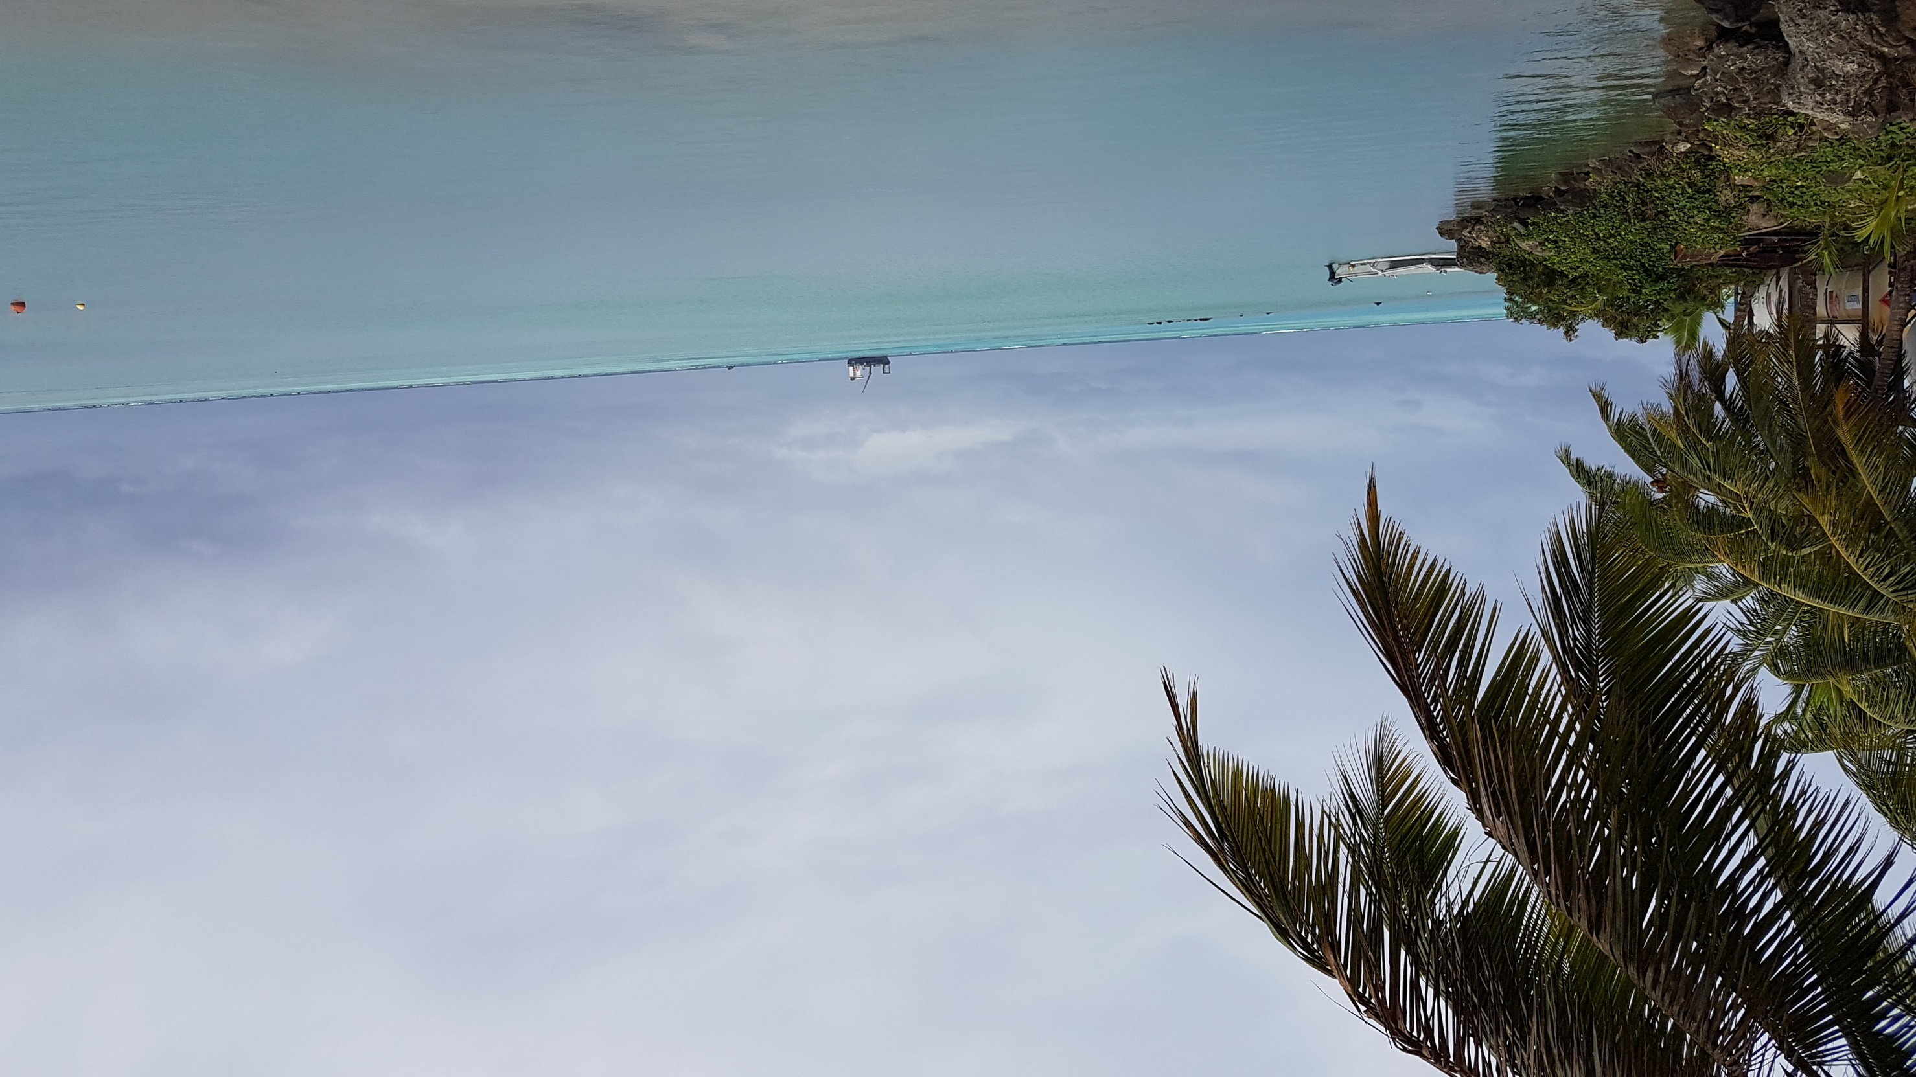
Outline
PRNI project
PRNI data portal
Outcomes

Slide 3
PRNI (Pacific Regional Navigation Initiative)
Funded by New Zealand Ministry of Foreign Affairs and Trade (MFAT)
3 year project , 2015 - 2018
Focused on:
Navigation related aspects of maritime safety, in particular to support Pacific Island countries fulfil obligations relating to hydrography and nautical charting under UN safety of Life at Sea (SOLAS) convention
3 targeted countries (Tuvalu, Kiribati and Vanuatu)

Slide 4
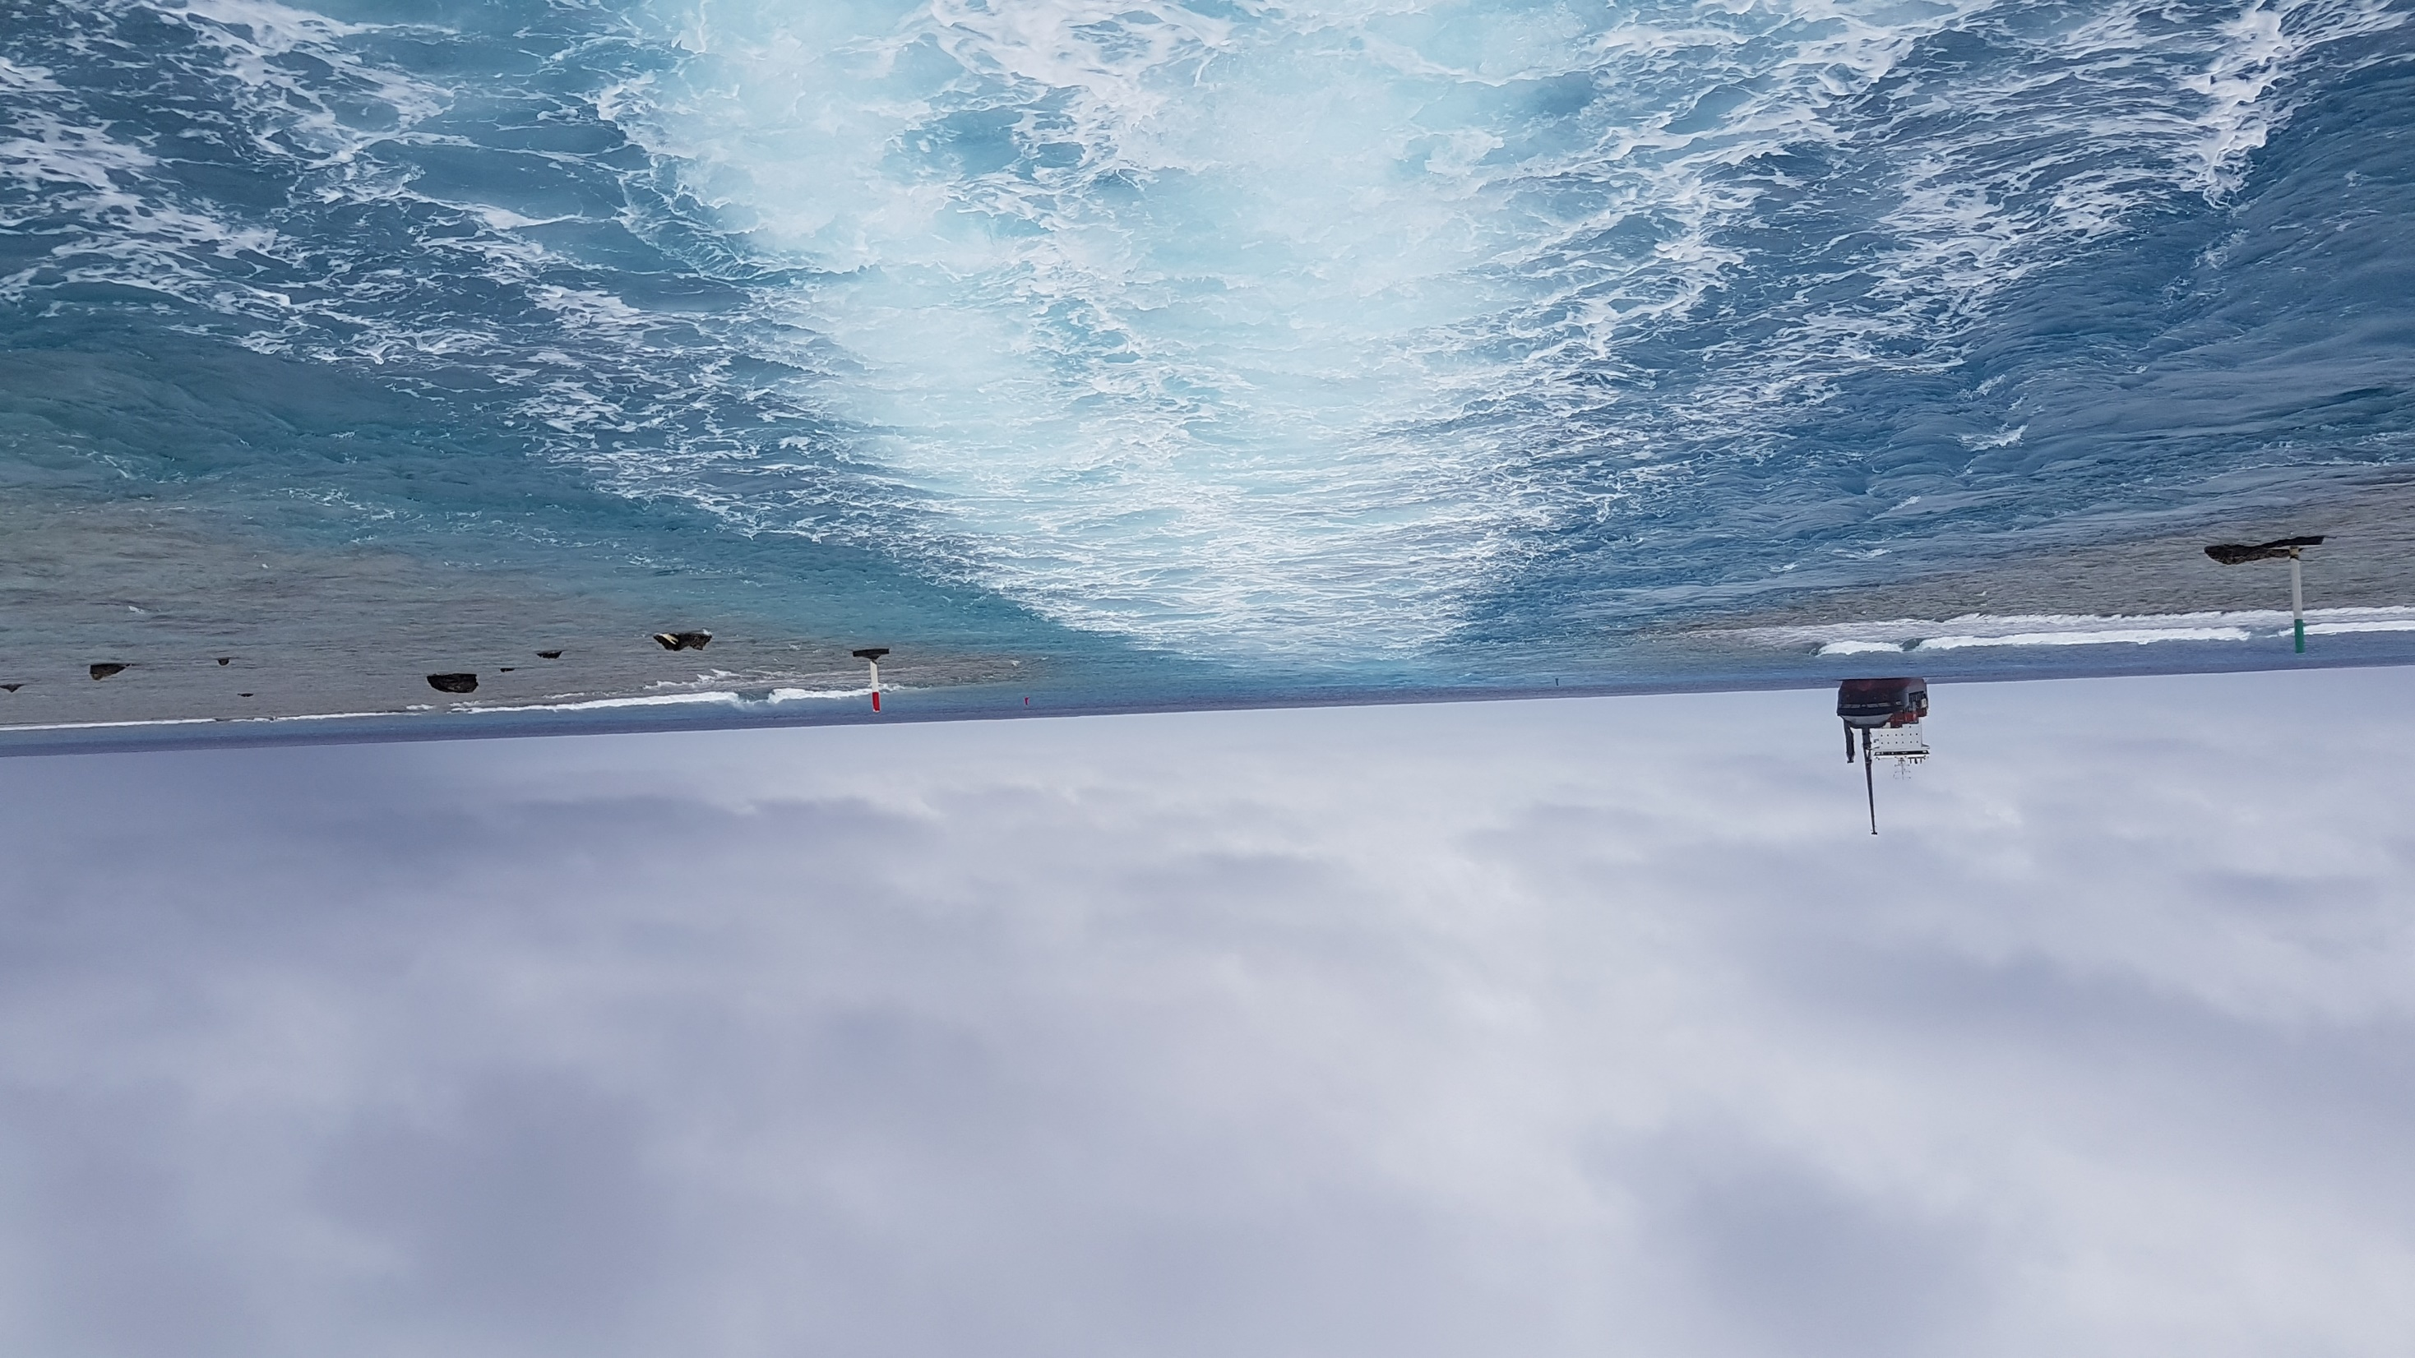
Staff involved in Data Discovery Output
Senior Hydrographic surveyor- David Mundy
Hydrographic surveyor – Salesh Kumar
Senior Geospatial Systems Architect – Sachindra Singh
Geospatial administrator – Keleni Rasiqa

Slide 9
Output 1 – Data Discovery
Examination of SPC data holdings and subsequent analysis for suitability for charting
Provision of means of regular promulgation of updated list and associated access to PCA’s
Obtaining release agreements with PICTs for release of data held by SPC to PCA’s
Activities completed include:
Review of all SPC data holdings
Secured 8 out of 17 PIC’s data release agreement
PRNI data portal complete
Data release matrix (excel spreadsheet MEDIN Format) complete
Data for 4 countries released to PCA (LINZ)
Username and password provided for PCA (UKHO and LINZ) and PCA’s
Notes:
Data stored on CD, paper, servers,

Slide 10
MEDIN | Country | Area | Year | Subject | Type of Survey | Format of Infor | Projection | West Bound Longitude | North Bound Latitude | East Bound Longitude | South Bound Latitude
 | Niue | Niue | 2005 Apr 29th - May 13th | Bathymetry | Multibeam Survey | Dataset | UTM Zone 2S (WGS 84) | -169.962081 | -18.942237 | -169.76113 | -19.167158
 |  |  |  |  |  | Report
 | Niue | Niue, Alofi Wharf | 1994 | Bathymetry | Multibeam survey | dataset | UTM Zone 2S (WGS 84) | -169.928286 | -19.045565 | -169.9204551 | -19.0564
 |  |  |  |  |  | Report
 | Niue | Niue Alofi Wharf |  | Bathymetry | Multibeam Survey | Report | UTM Zone 2S (WGS 84) | -169.924 | -19.0476 | -169.919 | -19.0547
 |  | Niue Alofi Wharf | 2013 | Bathymetry | Multibeam Survey | Dataset |  | -169.924 | -19.0476 | -169.919 | -19.0547
Name of Information | PRNI file name | Geonetwork File identifier | PACGEO Links | PACGEO TITLE
Niue_bathy_all processed points | Niue_bathy_all processed points.xyz
niue_noaa_mbes_bathy_eez_200m_grid | nu_noaa_mbes_bathy_eez_200m_grid.xyz | NA | http://www.pacgeo.org/layers/geonode%3Aniue_noaa_mbes_bathy_eez_200m_grid | Niue Noaa Mbes Bathy Eez 200M Grid
niue_noaa_mbes_200m |  | NA | http://www.pacgeo.org/layers/geonode%3Aniue_noaa_mbes_200m | Niue Noaa Mbes 200M
niue_2005_noaa_mes_50m_grid_near_nu |  | NA | http://www.pacgeo.org/layers/geonode%3Aniue_2005_noaa_mes_50m_grid_near_nu | Niue 2005 Noaa Mes 50M Grid Near Nu
niue_2005_btm_zones_500m |  | NA | http://www.pacgeo.org/layers/geonode%3Aniue_2005_btm_zones_500m | Niue 2005 Btm Zones 500M
Niue ,2005, EU-EDF Technical Survey Report |  | e6bcf036-1d6b-445c-8056-9c42d2380e3f | http://www.pacgeo.org/documents/3017 | Niue, 2005, Bathymetry, EU-SOPAC Project Report 49
Niue, 1994, Bathymetry data, File format: MapInfo file in zip folders |  | 33b19d73-9709-46f6-8baf-87e81468bec9 | http://www.pacgeo.org/layers/geonode%3Aniue_1994_bathymetry | NIUE, 1994, SHALLOW WATER BATHYMETRY DATA
SOPAC Preliminary Report 0089: Shallow Water Bathymetry Database, PDF Format |  | d67776ba-3612-4a81-948c-1c16fe90c027 | http://www.pacgeo.org/documents/2990 | SOPAC Preliminary Report 0089: Shallow Water Bathymetry Database, 1997,Report
PR157_RBS-Alofi_fnlpre-prnt_080613 |  | No record in Geonetwork | http://www.pacgeo.org/documents/2572 | Niue, Alofi, 2013, Multibeam Bathymetric and Geotechnical Investigations, Report
Notes:
Marine Environmental Data Information Network MEDIN Website: www.oceannet.org . Introduction to British Oceanographic Data Centre - The UK National Oceanographic Data Centre, CME programme

Slide 11
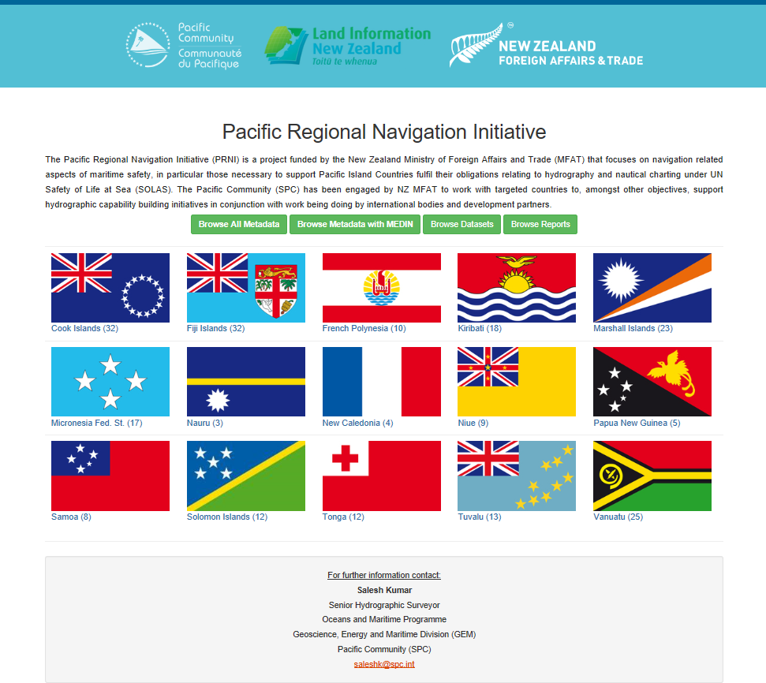
http://www.pacgeo.org/prni/

Slide 20
Thank you

